Slide 1
The Big Data Revolution for the Human and Political Sciences
Josh Cowls
Oxford Internet Institute
with contributions from Eric Meyer, Ralph Schroeder and Linnet Taylor

Slide 2
Overview
Background
Definitions
Three challenges:
Practical
Ethical
Epistemological
Future directions

Slide 3
Background
Research Assistant at the Oxford Internet Institute, 2013 - present
Projects:
Accessing and Using Big Data to Advance Social Science Knowledge
Big UK Domain Data for the Arts and Humanities
Editing the Public Sphere

Slide 4
Accessing and Using Big Data to Advance Social Science Knowledge
Funded by the Alfred P. Sloan Foundation
2012 – 2014
Data sources:
125 interviews, mainly with social scientists but some interviewees from business, government
Reports, workshops, publications
No representative sample, but some patterns of disciplinary and skills background and career trajectory
NB where unattributed, quotes used in this presentation are excerpted from interviews conducted as part of this project.

Slide 5
Defining Big Data

Slide 6
Big Data: our definition
Big data are data that are unprecedented in scale and scope in relation to a given phenomenon.
They are often streams of data (rather than fixed datasets), accumulating large volumes, often at high velocity.

Slide 7
Big Data: other definitions
‘Transactional’ (Margetts et al)
‘Things that one can do at a large scale that cannot be done at a smaller one’ (Mayer-Shonberger and Cukier)
The ‘3 Vs’: volume, velocity, variety – but also veracity, visualisability? (Gartner)

Slide 8
... what Big Data isn’t
A generalisable, quantifiable ‘amount’ of data
A race to the top (Mutually Assured Distraction)
The same for every discipline, field or sector

Slide 9
A more workable definition
The Big Data phenomenon might be less about what the dataset is and more about how we work with it

Slide 10
Three challenges of using big data
Practical
Epistemological
Ethical

Slide 11
Three challenges of using big data
Practical
Epistemological
Ethical

Slide 12
The practical challenge
The big data skills gap
Growth of collaboration: the case of web archives

Slide 13
The Big Data skills gap
“
I’m self taught. I had to learn a lot of the stuff that I’m using now by myself because there weren’t any provisions in the courses that I took either as an MSc or as a DPhil. ... social scientists don’t get good training to work in multidisciplinary teams of the sort that big data require”
Sandra Gonzalez-Bailon, Annanberg School of Communication, University of Pennsylvania

Slide 14
The Big Data skills gap
“
I think the problem is the skills gap. I don’t think lots of political science departments are really keyed into teaching this area. They might want to hire computer scientists to do some of it, but they don’t see that their political scientists should have this sort of skill in their tool kit, they don’t see it in the same way as even quantitative statistics, [but] I think being able to manipulate data is much more important than knowing how to run a series of statistical tests, which may or may not be useful.
Jonathan Bright, Oxford Internet Institute

Slide 15
The Big Data skills gap- Burrows
“
Well, no I think sociology and the social sciences should always, but this is just a personal view, should always be driven by interesting, substantive issues ... I don’t think people should build up any a priori commitment to any particular methodological orientation ... So as long as people are driven by interesting substantive questions, the analytics, and data and the approaches seem to me to fundamentally secondary and that’s why we’re failed, as a community, because our division of labour has put us into segments such that we develop particular orientations
Roger Burrows, Goldsmiths, University of London

Slide 16
But the skills gap runs both ways...

Slide 17
“
So my level of understanding drops off at a certain point because I’m not a trained technical person, and that’s frustrating as a director of the organization, not really knowing how long something takes – that’s my own failing. On their part I think the technical-minded people have a certain… it’s hard to describe actually. Putting it not very generously there’s almost a know-it-all attitude that people who are trained in the social sciences don’t have, because I think they’re more accustomed to “There are many sides to an argument” whereas people who come out of engineering it’s like “There’s a right way and there’s a wrong way”.
Ron Deibert, Citizen Lab, University of Toronto, interviewed 21.11.2012
for Sloan Big Data Project (http://www.oii.ox.ac.uk/research/projects/?id=98)

Slide 18
“
I see some sociologists like [senior researcher on the project] and she always asks me, “Okay show me a code and explain to me which part of a code is doing which part, just very brief understanding okay how this computer program is working”. So I was learning some sociology from her and she is learning some computer science programming skills from me so it’s kind of mutual [laughing] influence which is how I learn something like that.
Ning Wang, OII, interviewed 10.30.2012 for Sloan Big Data Project (http://www.oii.ox.ac.uk/research/projects/?id=98)

Slide 19
“
I can find someone to optimise an algorithm, I can pay someone to build a website but what I want is someone that is going to be thinking the human side through every step of the way, and when you build an algorithm and when you write a line of code you ask, does this make sense in terms of the phenomena that I am trying to model or trying to interpret.
Joshua Introne, MSU, interviewed 26.7.13 for Sloan Big Data Project (http://www.oii.ox.ac.uk/research/projects/?id=98)

Slide 20
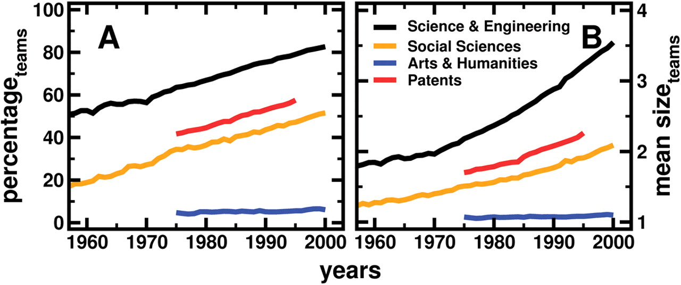
The Growth Of Teams
Source: S. Wuchty et al., (2007). The Increasing Dominance of Teams in Production of Knowledge. Science 316, 1036 -1039.

Slide 21
Combining technical and critical research: the case of web archives
AHRC funded project ‘Big UK Domain Data for the Arts and Humanities’ – terabytes of archived web data from the .uk domain
11 projects by trained humanities researchers (no prior web archive training)
Technical support from the British Library
Iterative approach to developing web archive research interface

Slide 22
Humanities research questions include...
Disability standards on UK websites
Online networks for the poetry community
Ministry of Defence recruitment strategy
British Euroscepticism
Ethnosemiotic study of London French

Slide 23
Addressing the practical challenges
Recommendations:
Draw on skills from across the academic spectrum ...
... but infuse social science and humanities curricula with more technical big data training and experience

Slide 24
Three challenges of using big data
Practical
Epistemological
Ethical

Slide 25
The epistemological challenge
Causation and correlation
Challenges of public opinion research
Understanding data in context

Slide 26
Forgetting causation?
“Big Data is all about correlation; it’s not about causation, which means that you don’t need to have a theory beforehand. You just start looking for correlation … so you don’t have any idea about the structure of the data, you just find a funny correlation.”
Sara Esposti, Open University Business School

Slide 27
Forgetting causation?
“a central concern of social science is, we don’t just want to find statistical associations, we actually want to uncover the underlying causal processes by which social systems work ... The data themselves don’t tell you about cause and effect, there’s actually a very complex often, complex inferential process you have to go through in order to extract from the data the things that you really care about
David Jensen, University of Massachusetts

Slide 28
Forgetting causation?
“I’ve been talking to some computer scientists who are rising stars, they’re really doing well, and they acknowledge that the way in which the field works, novelty is the key issue. And so there’s always an incentive or a pressure to keep on doing new stuff with new data, even though they might have wanted to go into more depth into something.
Sandra Gonzalez-Bailon, Annenberg School of Communication, University of Pennsylvania

Slide 29
Forgetting causation?
“if you look at the data long enough you’ll find predictive signals that are in fact completely spurious...for about, I think a 20 or 25 year period, the US stock market was perfectly correlated with the level of butter production in Bangladesh … if you look at hundreds and hundreds of these indicators, eventually you'll find something that just by pure chance matches what you're looking for. ”
Mike Cafarella, University of Michigan

Slide 30
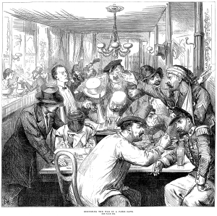
Grappling with unique big data challenges: the case of public opinion
The notion of public opinion was enlivened by the coffee houses of 17th Century Europe
Inferential statistics provided a rigorous, replicable basis for reporting public opinion, based on a random sample and MOE
Remained expensive, random sample difficult to construct, response rates dwindling
But: Bourdieu’s critiques
Notes:
Bourdieu: trad public opinion presumes we agree on questions, everyone has an answer, everyone is equally qualified to give an answer

Slide 31
Utility of big data approaches
n=all: beyond the sample
Cheaper (after initial investment)
More granularity, more insight?

Slide 32
But difficulties remain…
Representativeness
Reliability
Replicability

Slide 33
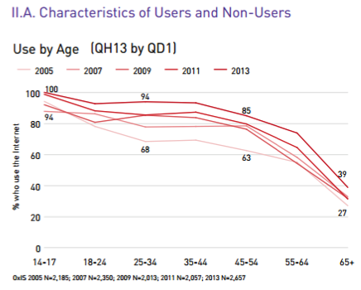
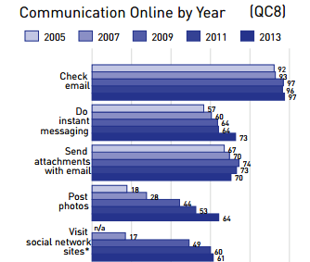
The challenge of representativeness
Amber Boydstun: anyone who does a Twitter study has to really work hard, I've noticed, to justify why we should care about Twitter because Twitter is not representative of the United States population or the world population, right. And it's not. And even if it was representative, or even if we don't care that it's not representative, it's really hard to figure out in any given study whether you're getting an over-sampling of those users who are just more active than other users.
Data from Dutton, W.H. and Blank, G., with Groselj, D. (2013) Cultures of the Internet: The Internet in Britain. Oxford Internet Survey 2013. Oxford Internet Institute, University of Oxford.

Slide 34
The challenge of reliability
Difficult to establish the meaning of latent messages
Platform specific behaviours (e.g. hashtags, likes) are not always understood
Political discourse often laced with sarcasm
Mike Thelwall: really the big problem that we haven’t cracked is that if someone tweets a sentiment it’s not necessarily what they’re feeling, it can be for a variety of reasons, so it doesn’t really reflect directly what they feel necessarily … so it’s quite a stretch to say that if someone tweets, “I’m happy” that they’re actually happy, to give a simple example

Slide 35
The challenge of replicability
Social data is often proprietary – getting access can be difficult, expensive or impossible
Sometimes access is limited to output – analysis takes inside black box
Challenges basic Popperian assumption of falsifiability
Nick Anstead: there are all these companies that do all this wonderful stuff, but actually as an academic researcher, using them is expensive … what do you actually get from working with these companies? Do you get raw data sets that you go and do stuff with yourself? More commonly, I would suggest, what you probably get is access to, sort of, a black box tool.

Slide 36
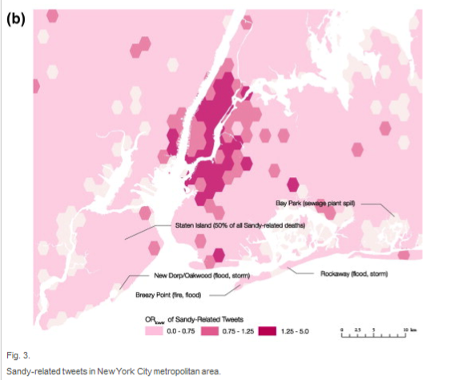
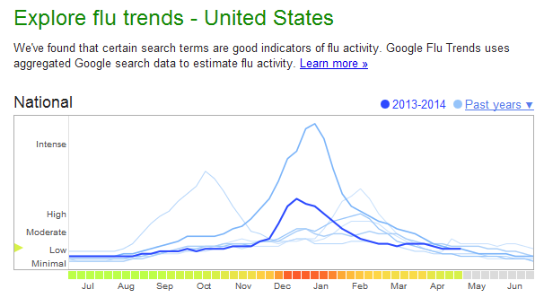
… and the implications aren’t just academic
Shelton, T et al, ‘Mapping the data shadows of Hurricane Sandy: Uncovering the sociospatial dimensions of ‘big data’. Geoforum Volume 52, March 2014, pps 167-79
Google flu trends – what went wrong?

Slide 37
… and the implications aren’t just academic
It’s hard to predict elections using Twitter
“[Of] 14 different attempts to predict elections based on Twitter data ... Only half of them were successful ... All of this looks close to mere chance”
Gayo-Avello 2012

Slide 38
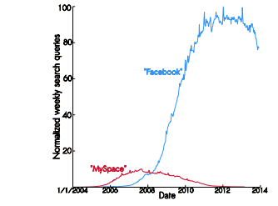
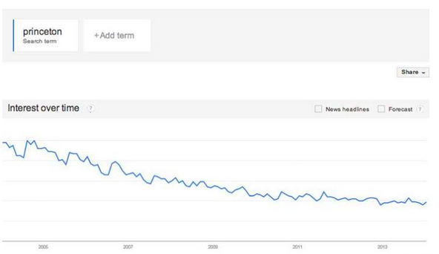
Recommendation: understanding the context of data
Example: Facebook isn’t going anywhere, and neither is Princeton
Canarella and Spechler 2014
Develin 2014

Slide 39
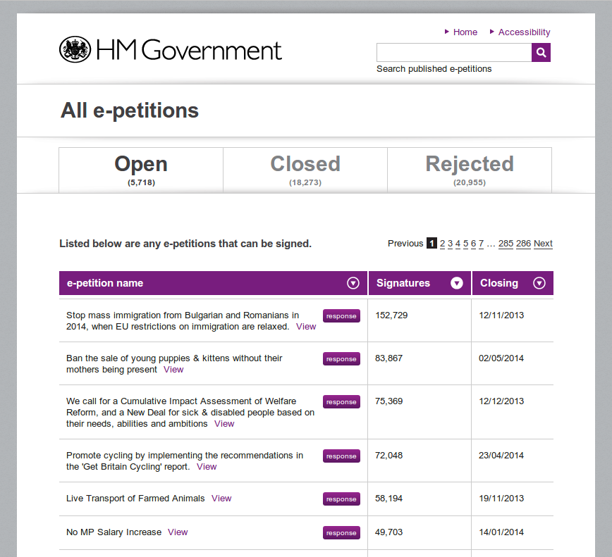
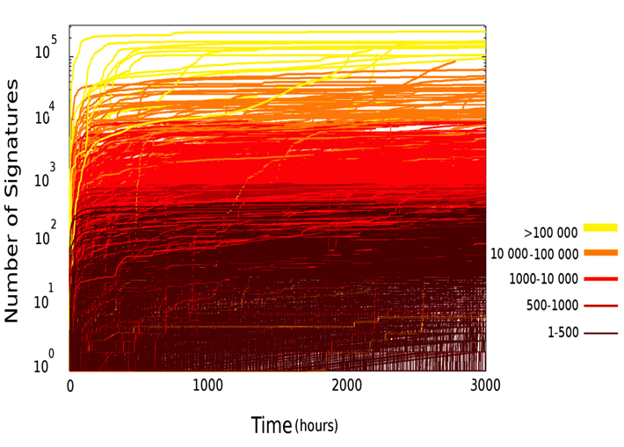
Recommendation: understanding the context of data
But it’s much simpler, conceptually speaking, to analyse online phenomena on their own terms
Yasseri, Hale & Margetts 2013

Slide 40
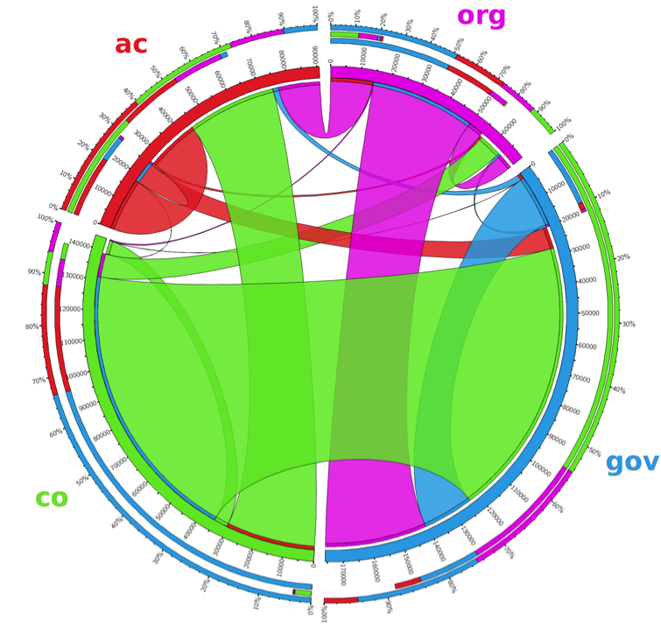
Recommendation: understanding the context of data
But it’s much simpler, conceptually speaking, to analyse online phenomena on their own terms
Hale, Yasseri, Cowls, Meyer, Schroeder & Margetts, presented at WebSci 2014

Slide 41
Three challenges of using big data
Practical
Epistemological
Ethical

Slide 42
The ethical challenge
What’s new with big data?
Putting big data in context: the LMIC activist perspective
Big data in academic versus commercial contexts

Slide 43
Big Data: what’s new for ethics?
major new questions revolving around free will and a loss of human agency:
new domains of action and knowledge
new accuracy in pinpointing individuals
new actors and new tools

Slide 44
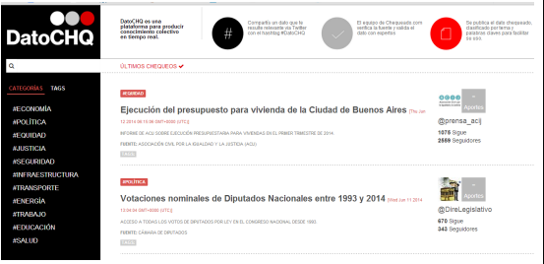
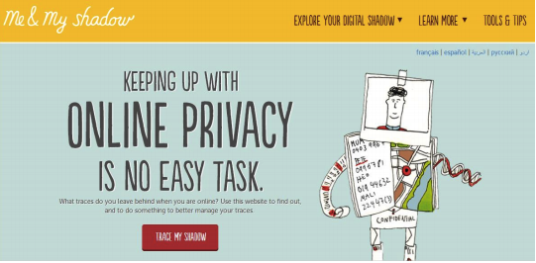
Using Big Data for Social Good in a developing country perspective
Big data is used both for exposing the powerful and protecting the powerless
Chequeado: online fact checking of politicians in in Argentina
Me and My Shadow (Tactical Technology): raising awareness of data sovereignty and surveillance

Slide 45
Academic and commercial uses
Links between academic and commercial bodies are blurring
But academia and business are different:
Approach: broad/abstract vs narrow/focused
Purpose: explanatory vs instrumental
People as: social actors vs consumers/voters...

Slide 46
Recommendations for ethics
Use of academic tools, e.g. IRBs
Improve public awareness of data use and abuse
Greater understanding of context of data creation (data versus ‘capta’)

Slide 47
Conclusions
Big data introduces numerous challenges to everyone who captures, stores and uses it
These challenges are as diverse as the data itself: practical, epistemological, ethical
No silver bullet – but greater awareness by data collectors and data subjects may act as best safeguard

Slide 48
Paper references/unanswered questions:
josh.cowls@oii.ox.ac.uk
@JoshCowls

