Slide 1
Task Assignment Optimization in Crowdsourcing (and its applications to political campaigns)
Sihem Amer-Yahia
DR CNRS @ LIG
Sihem.Amer-Yahia@imag.fr
POLIWEB PEPS
Grenoble Dec 8th, 2014

Slide 2
 | Traditional Campaigning | Social Media Campaigning
Sources | Onsite campaign officers
Report timeliness | Mixed (limited resources)
Report quality | ✔ (reliance on experts)
Report cost | High (time spent and bus tours)
Notes:
Origin and availability of workers

Slide 3
 | Traditional Campaigning | Social Media Campaigning
Sources | Onsite campaign officers | Tweets, FB posts, text messages, dedicated websites
Report timeliness | Mixed (limited resources) | ✔
Report quality | ✔ (reliance on experts) | Mixed (noisy; rumor and misinformation)
Report cost | High (time spent and bus tours) | ✔
Notes:
Origin and availability of workers

Slide 4
Barack Obama’s campaign, 2012 http://www.theguardian.com/world/2011/apr/04/barack-obama-twitter-facebook-election
An article in The Guardian (Monday 4 April 2011) noted that this was the first U.S. presidential re-election campaign to use Twitter and Facebook for promotion.
Twitter hashtag: #Obama2012
Bill Clinton and George Bush, spent the first phases of their campaigns on a nationwide bus tour.
Obama was covering the country with less effort, speaking to 500,000 of his grassroot activists via a live teleconference.

Slide 5
Share your story on
https://stories.barackobama.com/

Slide 6
Individual stories

Slide 7
Expressing Task Assignment in ECCO
Input: tasks to complete, human workers
Output: completed tasks
Each task has skill/quality/cost requirements
Each worker has human factors: skill, expected wage, acceptance ratio
Desirable properties:
Task-centric: high quality tasks (relevant workers), low cost
Worker-centric: balanced workload, good incentive (high pay, relevant tasks)
System-centric: low latency

Slide 8
Talk outline
Quick overview of existing crowdsourcing
Task assignment in ECCO

Slide 9
Crowdsourcing
Crowdsourcing: a variety of tasks
Micro-tasks: data gathering (e.g. picture/video tagging, opinion solicitation (e.g. restaurant ratings,)
Collaborative tasks: document editing (e.g., Wikipedia), creative design, fansubbing, solution outsourcing (e.g., Netflix contest)
Existing systems
Platforms: AMT, Turkit, Innocentive, CloudFlower, etc.
Crowd: volatile, asynchronous arrival/departure, various levels of attention/accuracy/expertise
3 primary processes
Worker skill estimation
Worker-to-task assignment
Task accuracy evaluation

Slide 10
Challenges
Who Evaluates What and How?
How to Estimate Worker Skills?
How to Assign Tasks to Workers?
How to do all of the above efficiently?
Magnified by:
Human factors
Scale

Slide 11
Related work
Developing a dedicated platform for each campaign is costly
Recent research undertakes some challenges in silo, for specific cases: e.g. real-time crowdsourcing, highly volatile crowds, single worker skill
Active learning strategies for task accuracy improvement [Boim et. Al. 2012, Krager et. al. 2011, Ramesh et. al. 2012]
Worker-to-task-assignment [Ho et. al. 2012]
Human involvement introduces uncertainty
Worker availability
Worker wage: deviations even among persons of the same profile, due to workload, time
Worker skill: may decline with workload, change with motivation

Slide 12
Task Assignment Optimization in
Knowledge-Intensive
Crowdsourcing
@VLDBJ 2015 (to appear)
joint work with:
Senjuti Basu Roy (UW Tacoma),
Gautam Das, Habibur Rahman,
Saravanan Thirumuruganathan (UT Arlington)

Slide 13
Maximize task quality under task-centric and worker-centric constraints
objective: maximize aggregated v_{t}
task quality constraint
aggregated worker skills and wages
task budget

Slide 14
Task Assignment Solution Overview
Task Assignment Problem is NP-hard (reduction using Multiple-Knapsack Problem)
Our approach:
Offline – Index Building for a workload of tasks
Online – Index Maintenance when tasks occurs
How to replace a worker who is not available or does not accept a task?

Slide 15
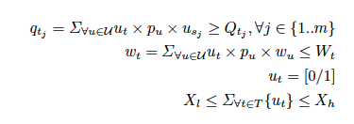
Optimal Solution Offline Index Building
IP-based

Slide 16
Approximation Solution for Offline Index Building
Objective function submodular and becomes monotonic when W2 = 0
Contribution to index building
A greedy deterministic algorithm with a 1-1/e approximation factor when submodular and monotonic
A greedy randomized algorithm with a 2/5 approximation factor when submodular
Contribution to index maintenance
Solve a marginal IP
Cluster workers to reduce size

Slide 17
Experimental Evaluation
Quality Experiments using multiple Applications
Collaborative Document Editing
Workers asked to produce reports on 5 different topics:
1) Political unrest in Egypt, 2) NSA document leakage, 3) Playstation games, 4) All electric cars and 5) Global warming
Scalability experiments
A collaborative crowd simulator

Slide 18
Quality Experiments
A total of 230 workers hired on AMT
A set of 8 multiple choice questions per task, to assess skills
Study conducted in multiple phases
Phase1- Skill and Cost of workers learned using benchmark dataset
Phase2- Task assignment
Phase3- Completed tasks evaluated by crowd workers
Notes:
What is the name of the place in Cairo where the
protests took place?" with possible answers: Tahrir Square,
Mubarak Plaza, Al Azhar Square,

Slide 19
AMT worker distributions (Egypt task)

Slide 20
AMT worker distributions (Egypt task)

Slide 21
Quality Assessment
Scale of 1-5 by 150 AMT workers
Compared to Benchmark and Online-greedy
Notes:
Benchmark (workers self-appoint themselves to articles after a skill-based pre-selection process, traditional as in AMT)
Online-Greedy (workers are assigned to the available tasks taking into account the workers’ marginal utility on each task; this is the adaptation of one
of the latest state-of-the-art online task assignment algorithms
On an average $1:81 is spent per task for Online-greedy, whereas, $1:936 and $1:84 are spent on SmartCrowd and Benchmark respectively.

Slide 22
Summary of Quality Experiments (from translation task)
Higher affinity impacts positively quality
A large group (beyond size 10) is less effective
Region-based affinity is more effective than age-gender based

Slide 23
Summary and Future Work
Crowdsourcing is a powerful paradigm for campaign reporting
Implicit reporting serves campaign awareness
Explicit reporting with recurring crowds opens new research opportunities for effective task assignment
Task assignment is effective when skill learning and task evaluation are possible
Research in this area may rely on a general-purpose crowdsourcing platform

Slide 24
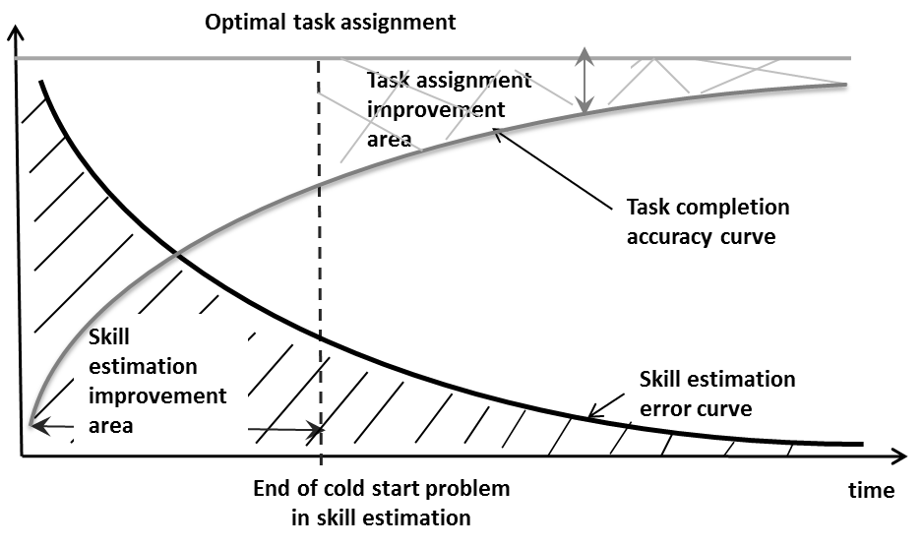
Opportunities

Slide 25
 | Traditional Campaigning | Social Media Campaigning | Future Campaigning?
Sources | Onsite campaign officers | Tweets, FB posts, text messages, dedicated websites | Online tweet analysis discovers and follows course of campaign
Report timeliness | Mixed (limited resources) | ✔ | ✔ (if tweet monitoring is accurate and timely)
Report quality | ✔ (reliance on experts) | Mixed (noisy; rumor and misinformation) | ✔ (via careful assignment)
Report cost | High (time spent and bus tours) | ✔ | ✔ (within budget)
Notes:
Origin and availability of workers

Slide 26
Social media for large studies of behavior http://www.sciencemag.org/content/346/6213/1063.summary?sid=084adb48-e72d-463d-81f6-cd71d3031d27
On 3 November 1948, the day after Harry Truman won the United States presidential elections, the Chicago Tribune published one of the most famous erroneous headlines in newspaper history: “Dewey Defeats Truman”
The headline was informed by telephone surveys, which had inadvertently under-sampled Truman supporters
Mounting evidence suggests that many of the forecasts and analyses being produced with social media analysis misrepresent the real world [1]
[1] Zeynep Tufekci: Big Questions for Social Media Big Data: Representativeness, Validity and Other Methodological Pitfalls. ICWSM 2014

Slide 27
Using Social media for large studies of behavior
For instance, Instagram is “especially appealing to adults aged 18 to 29, African-American, Latinos, women, urban residents” [2]
Pinterest is dominated by females, aged 25 to 34, with an average annual household income of $100,000 [3]
These sampling biases are rarely corrected for (if even acknowledged)
Population proxy effect has caused substantially incorrect estimates of political orientation on Twitter [4]
Academic culture that celebrates only positive findings. Without seeing failed studies, we cannot assess the extent to which successful findings are the result of random chance. Issue has been observed when predicting political election outcomes with Twitter [5]
[2] M. Duggan, J. Brenner, The demographics of social media users; www.pewinternet.org/2013/02/14/the-demographics-of-social-media-users-2012/
[3] 13 ‘pinteresting’ facts about Pinterest users; www.pinterest.com/pin/234257618087475827/
[4] Raviv Cohen, Derek Ruths: Classifying Political Orientation on Twitter: It's Not Easy! ICWSM 2013
[5] H. Schoen et al., Internet Res. 23, 528 (2013)

Slide 28
Share your story on obamacare.com

