Slide 1



The State of the Nation in Data Science Reproducibility
Khalid Belhajjame
https://sites.google.com/site/kbelhajjame
@kbelhajj

Slide 2
Open and transparent Communication
“Science is built upon the foundations of theory and experiment validated and improved through open, transparent communication. With the increasingly central role of computation in scientific discovery, this means communicating all details of the computations needed for others to replicate the experiment.
V. Stodden, D. H. Bailey, J. M. Borwein, R. J. LeVeque, W. Rider, and W. Stein. Setting the default to reproducible: Reproducibility in computational and experimental mathematics.

Slide 3

basic studies on cancer are unreliable, with grim consequences for producing new medicines in the future
Notes:
As an example, In this article, a researcher has found that many basic studies on cancer are unreliable, with grim consequences for producing new medicines in the future. This supports the need for testing research results.
http://www.reuters.com/article/2012/03/28/us-science-cancer-idUSBRE82R12P20120328
During a decade as head of global cancer research at Amgen, C. Glenn Begley identified 53 "landmark" publications -- papers in top journals, from reputable labs -- for his team to reproduce. Begley sought to double-check the findings before trying to build on them for drug development.
Result: 47 of the 53 could not be replicated. He described his findings in a commentary piece published on Wednesday in the journal Nature.

Slide 4
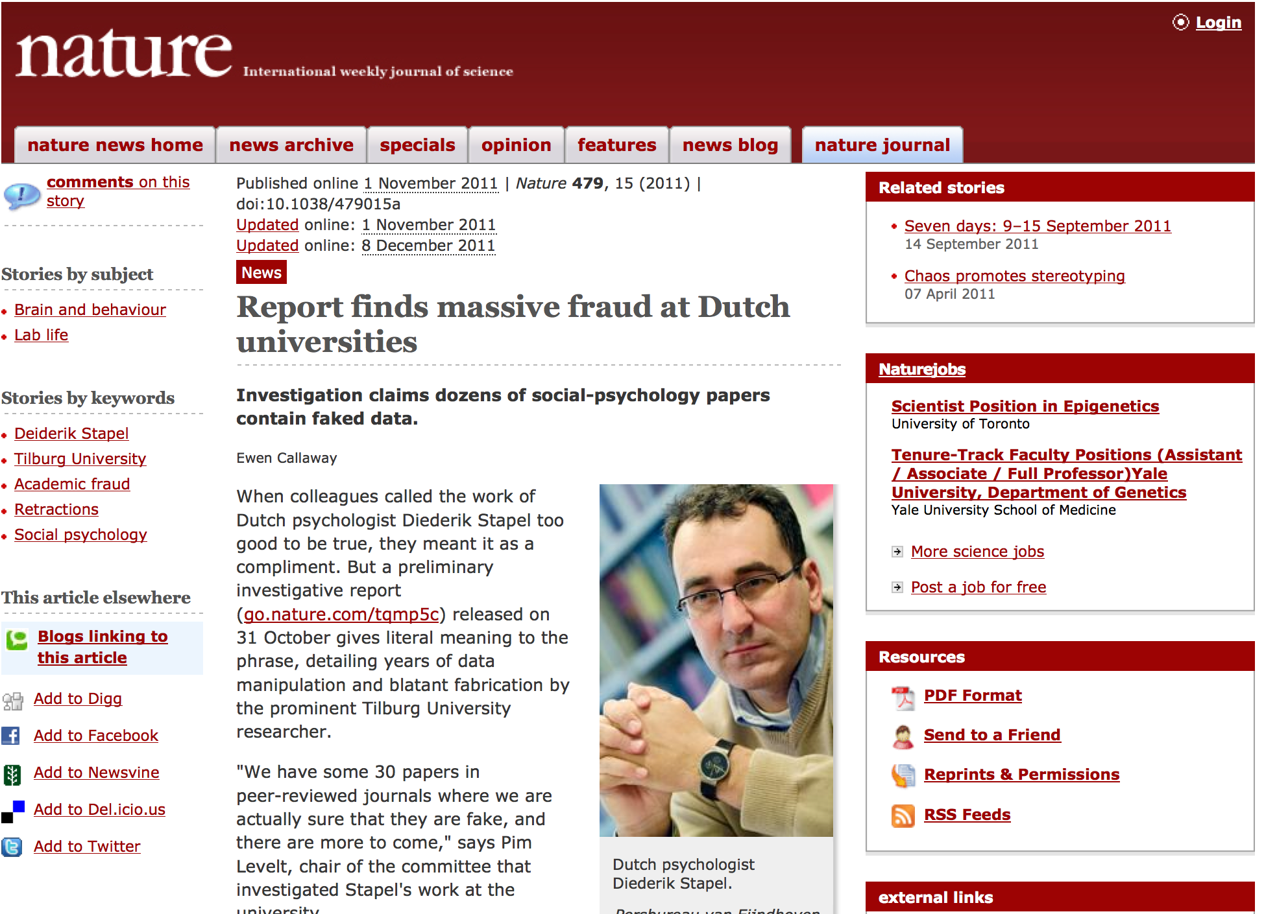
The research result, obtained by Stapel and co-workers Roos Vonk (Radboud University) and Marcel Zeelenberg (nl) (Tilburg University), showing that meat eaters are more selfish than vegetarians, which was widely publicized in Dutch media is suspected to be based on faked data.

Slide 5
Replication
Replication means conducting studies with independent:
  Investigators
  Data,
  methods,
  Laboratories,
  Instruments.
Replication is the ultimate standard for strengthening evidence and trust in scientific findings.
However, replication is most of the time not possible: expensive (time and money), opportunistic

Slide 6


Reproducibility
(Re)useless
Way too expensive
Reproducibility
Reproducible Research:
Make data and code
available so that others
may reproduce findings
Scholarly Article, is not enough
Replication

Slide 7
Levels of Reproducibility
Cost
Replicability
Workability
Reproducibility
(Almost) Nothing
Reproducibility Level

Slide 8
Culture of Reproducibility
The huge increases in performance both at the level of hardware and software, meant that highly complex analysis are possible.
However, these same advances meant a higher risk of generating results that cannot be reproduced.
Notes:
We need to institute the culture of reproducibility.

Slide 9
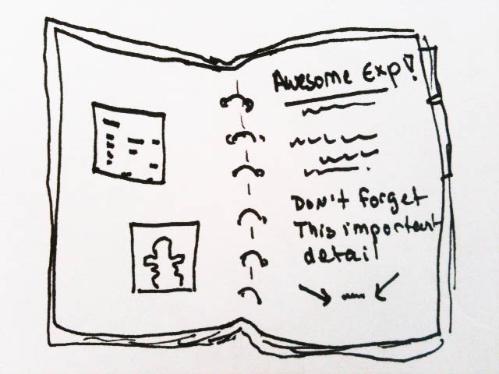
Culture of Reproducibility
Researchers in experimental biology use carefully lab notebooks to document different aspects of their experiments.
This is not the case for computational scientists who tend to run their analysis with no clear record of the exact process they followed or intermediary datasets (results) they used and generated.
It is therefore possible that numerous published results may be unreliable or even completely invalid.

Slide 10
Often, there is no record of the process (workflow) that produced the published computational results in scholarly communications.
Even the code is missing, or underwent changes.
  It cannot be used to process the data referred to, (if we are lucky).

Slide 11
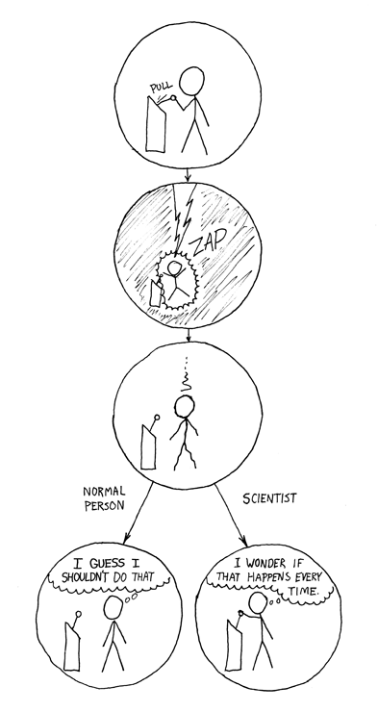
Open and transparent Communication
“The reproducible research movement recognizes that traditional scientific research and publication practices now fall short …, and encourages all those involved in the production of computational science ... to facilitate and practice really reproducible research.”
We witnessed recently the emergence of a number of methods and tools for enabling reproducibility
V. Stodden, D. H. Bailey, J. M. Borwein, R. J. LeVeque, W. Rider, and W. Stein. Setting the default to reproducible: Reproducibility in computational and experimental mathematics.

Slide 12
Computational Reproducibility Landscape
System-Level Reproducibility
Reprozip
Burrito
Scripting oriented Reproducibility
IPython
Knitr
Workflow oriented reproducibility
Galaxy
Taverna
ES3
IJulia
Vistrails
Article Centered Reproducibility
SOLE
DEEP
SHARE
Investigation oriented Reproducibility
ISA
Research Object
FuGE

Slide 13
Reprozip

Slide 14
Reprozip

Slide 15
Reprozip

Slide 16
Reprozip
Figure taken from Chirigati et al., 2012

Slide 17
Reproducibility Landscape
System-Level Reproducibility
Reprozip
Burrito
Scripting oriented Reproducibility
IPython
Knitr
Workflow oriented reproducibility
Galaxy
Taverna
ES3
IJulia
Vistrails
Article Centered Reproducibility
SOLE
DEEP
SHARE
Investigation oriented Reproducibility
ISA
Research Object
FuGE

Slide 18
Ipython Notebook
IPython provides a rich architecture for interactive computing with:
  A browser-based notebook with support for code, text, mathematical expressions, inline plots and other rich media.
  Support for interactive data visualization and use of GUI toolkits.

Slide 19
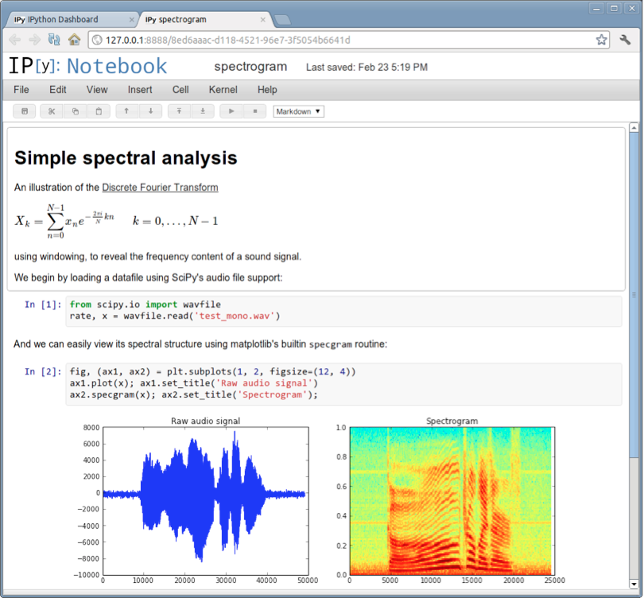
IPython

Slide 20
Reproducibility Landscape
System-Level Reproducibility
Reprozip
Burrito
Scripting oriented Reproducibility
IPython
Knitr
Workflow oriented reproducibility
Galaxy
Taverna
ES3
IJulia
Vistrails
Article Centered Reproducibility
SOLE
DEEP
SHARE
Investigation oriented Reproducibility
ISA
Research Object
FuGE

Slide 21
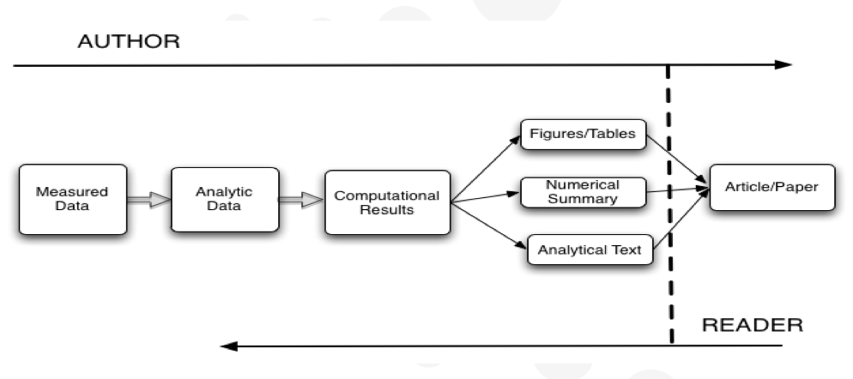
Article Centered Reproducibility: SOLE
Inputs to computational science are not linked with its outputs.
  Inputs: Large quantities of data, complex data manipulation and/or numerical simulation use of large and often distributed software stacks.
  Outputs: Research papers (text-based, non-interactive)
Authors and Readers
  approach computational
  science from opposite directions
The objective of SOLE is to link research papers with auxiliary resources that have been utilized, e.g., datasets, software programs, files, etc.

Slide 22
Reproducibility Landscape
System-Level Reproducibility
Reprozip
Burrito
Scripting oriented Reproducibility
IPython
Knitr
Workflow oriented reproducibility
Galaxy
Taverna
ES3
IJulia
Vistrails
Article Centered Reproducibility
SOLE
DEEP
SHARE
Investigation oriented Reproducibility
ISA
Research Object
FuGE

Slide 23
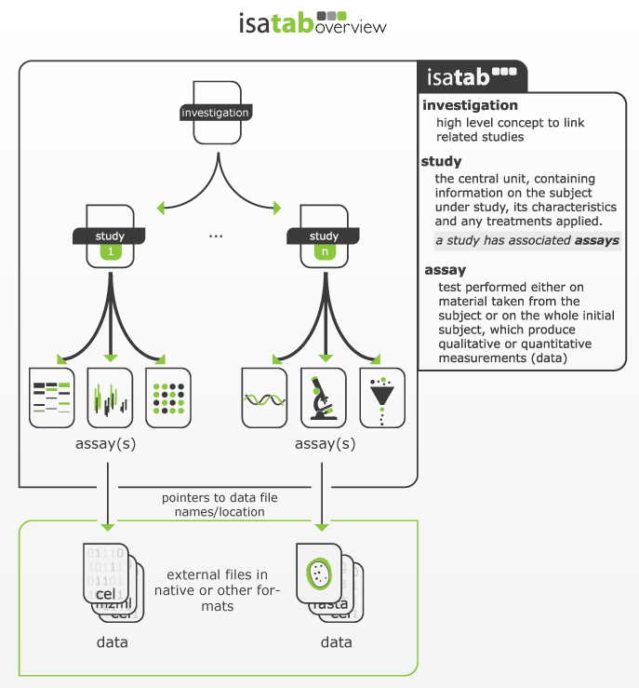
Investigation Oriented Reproducibility: ISA
Assists users to submit the structured content via simple templates and an internal authoring tool
Performs value-added semantic annotation of the experimental metadata

Slide 24
Scientific Workflow Reproducibility

Slide 25
Elements of the solution
Reproducibility
Summarization
Duplicate Detection
Combating Decay of

Slide 26
Workflow Decay
Scientific Workflow Reproducibility

Slide 27
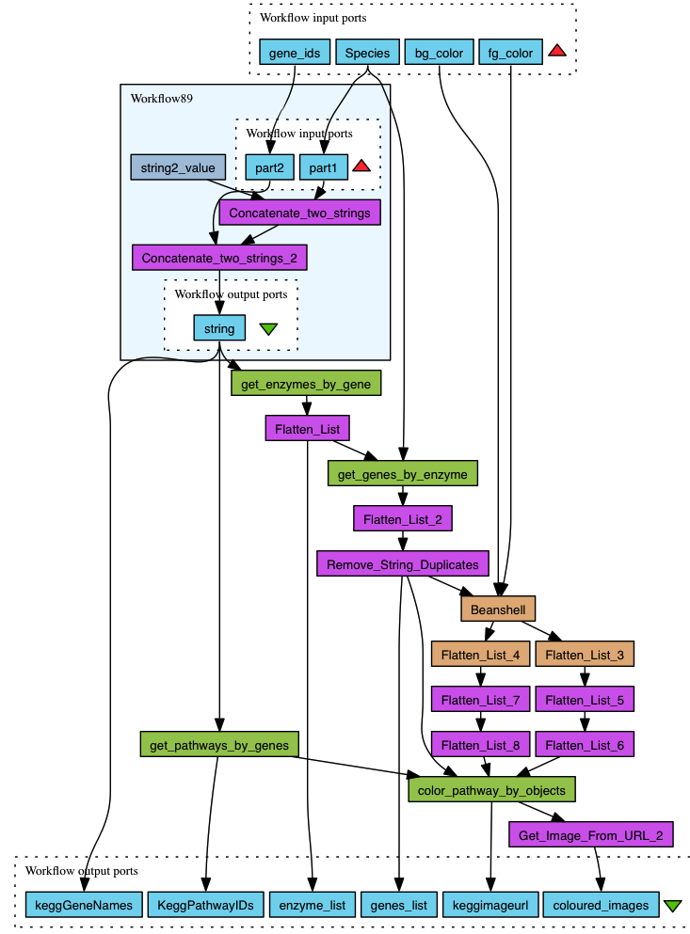
Scientific Workflows
Data driven analysis pipelines
Systematic gathering of data and analysis tools into computational solutions for scientific problem-solving
Tools for automating frequently performed data intensive activities
Provenance for the resulting datasets
  The method followed
  The resources used
  The datasets used
Notes:
In this age of data-intensive science we’re witnessing the unprecedented generation and sharing of large scientific datasets, where the pace of data generation has far surpassed the pace of conducting analysis over the data. Scientific Workflows [6] are a recent but very popular method for task automation and resource integration. Using workflows, scientists are able to systematically weave datasets and analytical tools into pipelines, represented as networks of data processing operations connected with dataflow links.
(Figure 1 illustrates a workflow from genomics, which “from a given set of gene ids, retrieves corresponding enzyme ids and finds the biological pathways involving them, then for each pathway retrieves its diagram with a designated coloring scheme”).
As well as being automation pipelines, workflows are of paramount importance for the provenance of data generated from their execution [6]. Provenance refers to data’s deriva- tion history starting from the original sources, namely its lineage.

Slide 28
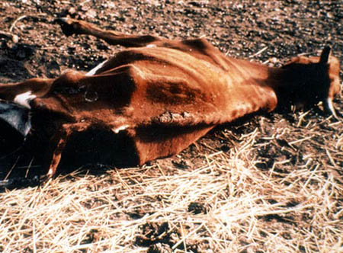


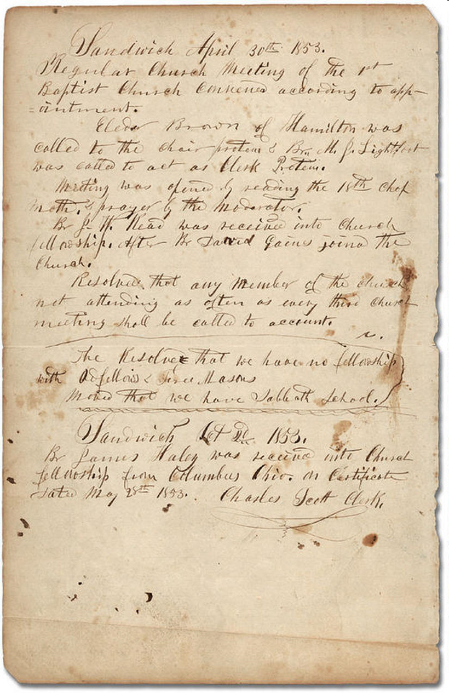
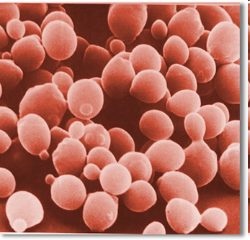

Science with workflows
GWAS, Pharmacogenomics
Association study of Nevirapine-induced skin rash in Thai Population
Observing Systems Simulation Experiments
JPL, NASA
Trypanosomiasis (sleeping sickness parasite) in
African Cattle
Astronomy & HelioPhysics
Library Doc
Preservation
Systems Biology of Micro-Organisms
BioDiversity Invasive Species Modelling
[Credit Carole A. Goble]

Slide 29





Workflows: A Means for Preserving Scientific Methods
Scientific workflows are primarily used to specify and enact in silico experiments
However, they can also be used as a a means to document the experiment that the scientist ran, and even repurpose it!
Scientific workflows
  Increasingly adopted in modern sciences.
  Transparent documentation of experimental methods
  Repeatable and configurable
chromosome17
chromosome37
Kegg pathway query
Kegg pathway query
Detect common pathways
Common pathways
Notes:
This is partly witnessed by existing workflow repositories, notably myExperiment and crowdLab, which provide scientists with the means to store, share, publish and reuse workflows.
One of the good features of scientific workflows vis a vis reproducibility is that they are repeatable and configurable.
Well in principle.
Unfortunately, our experience suggests that workflows are likely to suffer over time from decay hindering or reducing the ability to execute them and reproduce the same results.

Slide 30
Workflow Decay
A decayed or reduced ability to be executed or produce the same results
To better understand workflow decay, we conducted an empirical analysis to identify the causes of workflow decay.
To do so, we analyzed a sample of real workflows to determine if they suffer from decay and the reasons that caused their decay

Slide 31

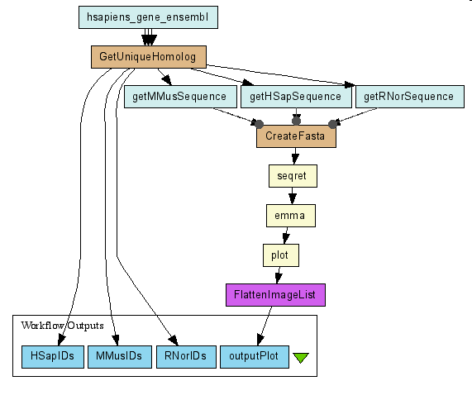

Experimental Setup
Taverna workflows from myExperiment.org
  Taverna 1
  Taverna 2
Selection process
  By the creation year
  By the creator
  By the domain
Software environment
  Taverna 2.3
Experiment metadata
  June-July 2012
  4 researchers
Taverna

Slide 32
Analyzed Workflows
Number of Taverna 1 workflows from 2007 to 2011
 | 2007 | 2008 | 2009 | 2010 | 2011
Tested | 12 | 10 | 10 | 10 | 4*
Total | 74 | 341 | 101 | 26 | 13
Number of Taverna 2 workflows from 2009 to 2012
 | 2009 | 2010 | 2011 | 2012
Tested | 12 | 10 | 15 | 9
Total | 97 | 308 | 289 | 184

Slide 33
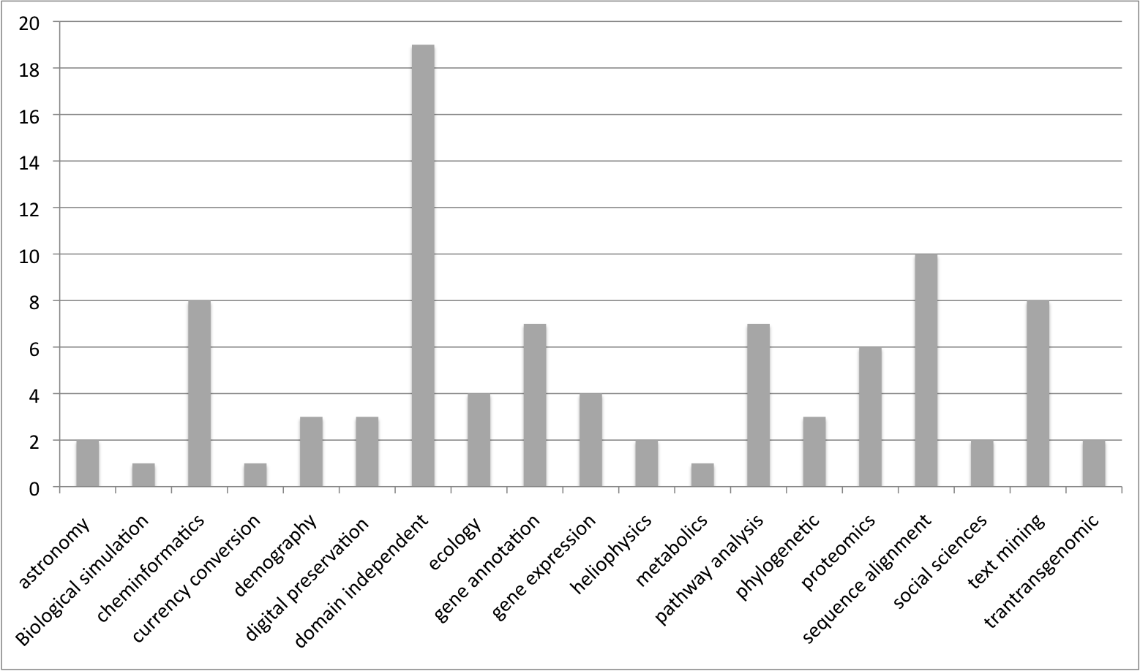
Profile of Analyzed Workflows

Slide 34
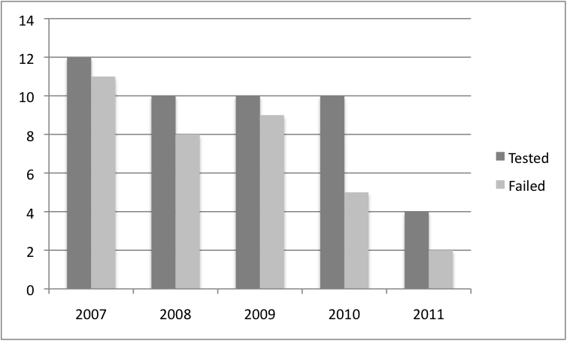
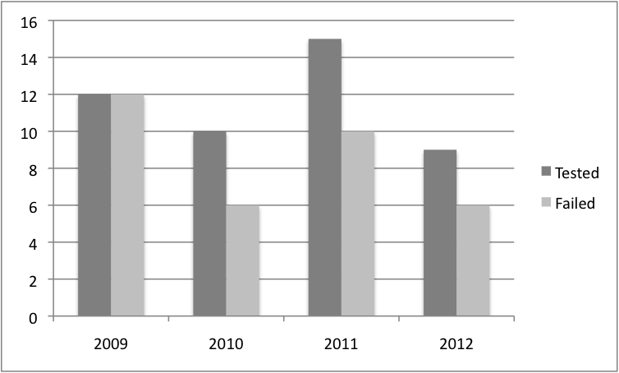
The Proportion of Decay
Taverna 1
75% of the 92 tested workflows failed to be either executed or produce the same result (if testable)
Those from early years (2007-2009) had 91% failure rate
Taverna 2

Slide 35
The Cause of Decay
Manual analysis
  By the validation report from Taverna workbench
  By interpreting experiment results reported by Taverna
Identified 4 categories of causes
  Missing example data
  Missing execution environment
  Insufficient descriptions about workflows
  Volatile third-party Resources
Other unconsidered possible factors
  Changes in the local operating environment (hardware, OS, middleware, compiler, etc)
Notes:
C. Missing execution environment
The execution of a workflow may rely on a particular local execution environment, for example, a local R server or a specific version of workflow execution software. Some of our test workflows exhibit this type of decay. Taverna often provides sufficient information about missing libraries, and sometimes workflow descriptions provide a warning about the requirement for a specific library. This type of decay appears to be fixable by installing the missing software, albeit requiring some effort.
D. Insufficient descriptions about workflows
Sometimes a workflow workbench cannot provide sufficient information about what caused the failure of a workflow run. Additional descriptions in the workflow can play an important role in assisting users reusing the workflows to understand the purpose of the workflow and its expected outcomes.

Slide 36
Decay Caused by Third-Party Resources
Causes | Refined Causes | Examples
Third party resources are not available | Underlying dataset, particularly those locally hosted in-house dataset, is no longer available | Researcher hosting the data changed institution, server is no longer available
 | Services are deprecated | DDBJ web services are not longer provided despite the fact that they are used in many myExperiment workflows
Third party resources are available but not accessible | Data is available but identified using different IDs than the ones known to the user | Due to scalability reasons the input data is superseded by new one making the workflow not executable or providing wrong results
 | Data is available but permission, certificate, or network to access it is needed | Cannot get the input, which is a security token that can only be obtained by a registered user of ChemiSpider
 | Services are available but need permission, certificate, or network to access and invoke them | The security policies of the execution framework are updated due to new hosting institution rules
Third party resources have changed | Services are still available by using the same identifiers but their functionality have changed | The web services are updated

Slide 37
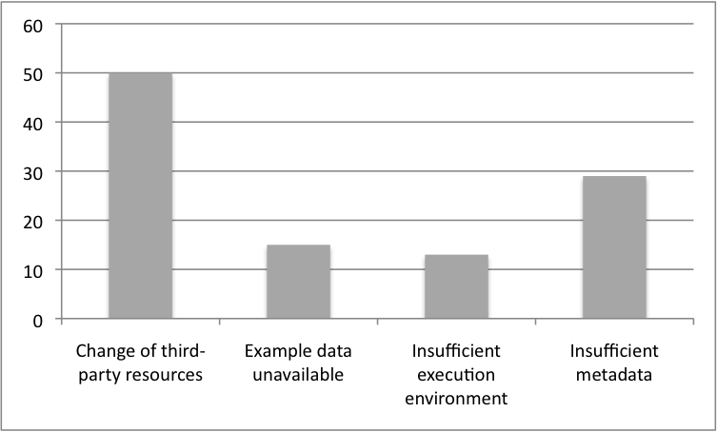
Summary of Decay Causes
50% of the decay was caused by volatility of 3rd-party resource
  Unavailable
  Inaccessible
  Updated
Missing example data
  Unable to re-run
Missing execution environment
  Such as local plugins
Insufficient metadata
  Such as any required dependency libraries or permission information

Slide 38
Repairing Workflows
Scientific Workflow Reproducibility

Slide 39
Preserving Workflow Against Decay For Enabling Reproducibility
Some services that compose workflows are annotated using concepts from domain ontologies
Such annotations can be used to repair workflow
  Identify available services that can play the same role as an unavailable service within a workflow.

Slide 40

Ontologies Used For Annotating Web Services
Task ontology: captures information about the action carried out by service operations within a domain of interest, e.g., Sequence_alignment and Protein_identification
Domain ontology: captures information about the application domains covered by operation parameters, e.g., Protein_record and DNA_sequence
Notes:
Structural information about a given web service, its component operations and the data types of the input and output parameters are readily available, e.g., WSDL documents supplies this information However, such information is not sufficient for locating the service operations able to substitute an unavailable one; rather precise information that explicitly describes, amongst others, the task performed by the service operation and the semantics of its input and outputs, is needed.
This additional information is commonly encoded in the form of annotations that relates the service elements to concepts from ontologies that specify the semantics of the service elements in the real world. In this work, we consider that web services are annotated using the following ontologies.

Slide 41
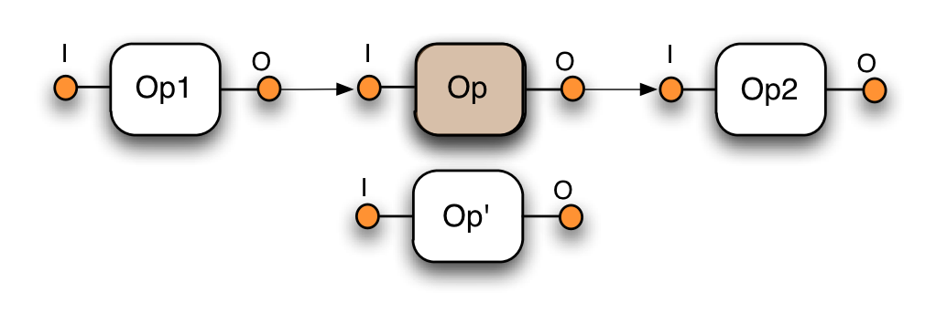

Task Replaceability
Task replaceability: For an operation op2 to be able to substitute an operation op1, op2 must fulfil a task that is equivalent to or subsumes the task op1 performs:
Notes:
Using the semantic annotations of web services presented, we constructed an algorithm that supports users by automatically locating substitutes for unavailable service operations. This algorithm constructed relies on the following replaceability criteria.

Slide 42
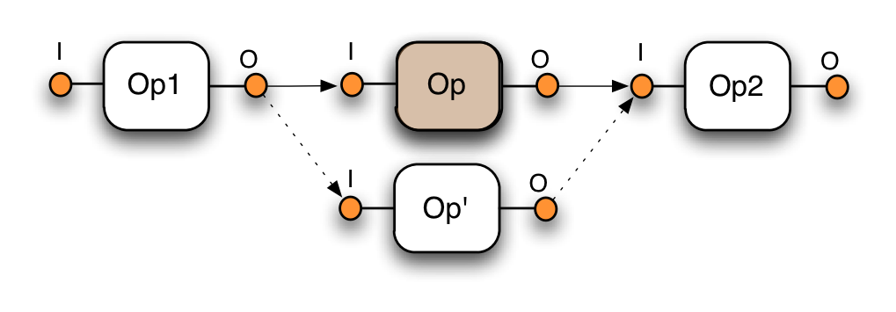
Parameter compatibility
Parameter replaceability: To be compatible the domain of the output must be the same as or subconcept of the domain of the subsequent input.

Slide 43
Limitations
While the method just presented is sound, its practical applicability is hindered by the following facts
Semantic annotations of web services are scarce.
Our experience suggests that a large proportion of existing semantic annotations suffer from inaccuracies
  As a result, a substitute that is discovered for replacing an unavailable operation using such annotations may turn out to be unsuitable, and, inversely, a suitable substitute may be discarded.
Notes:
While, the algorithm we developed is sound, its practical applicability is hindered by the following facts. First, semantic annotations of web services are scarce: the number of web services that are annotated lags well behind the growing number of available web services. As a result, the likelihood of locating substitute operations using the algorithm described in [3], is small. Second, our experience with QuASAR2, a tool that we developed for testing semantic web service annotations, suggests that a large proportion of existing se- mantic annotations suffer from inaccuracies. As a result, a substitute that is discovered for replacing an unavailable operation using such annotations may turn out to be unsuitable, and, inversely, a suitable substitute may be discarded.

Slide 44
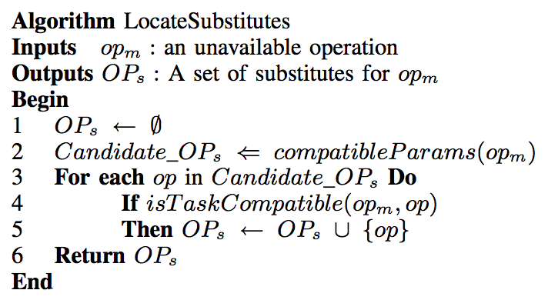
Discovering Substitute Services Using Existing Workflow Specifications and Provenance traces
Existing Workflow Specifications
Provenance traces of missing operations
Notes:
The overall approach that we adopt is captured by the following algorithm.
The algorithm is composed of two main steps.
First, given a missing operation, the set of operations Candidate ops that are able to replace such an operation in terms of input and output parameters are located (line 2).
The second step consist in checking which operations among the candidates returned by the above step perform the same task as the missing operations.
Regarding parameter compatibility, we make use of existing workflow specifications to locate operations that are compatible with the missing one in terms of parameters.
And, to check compatibility in terms of task, we use provenance traces of the missing operations.
In what follows I will present in details these two steps.

Slide 45
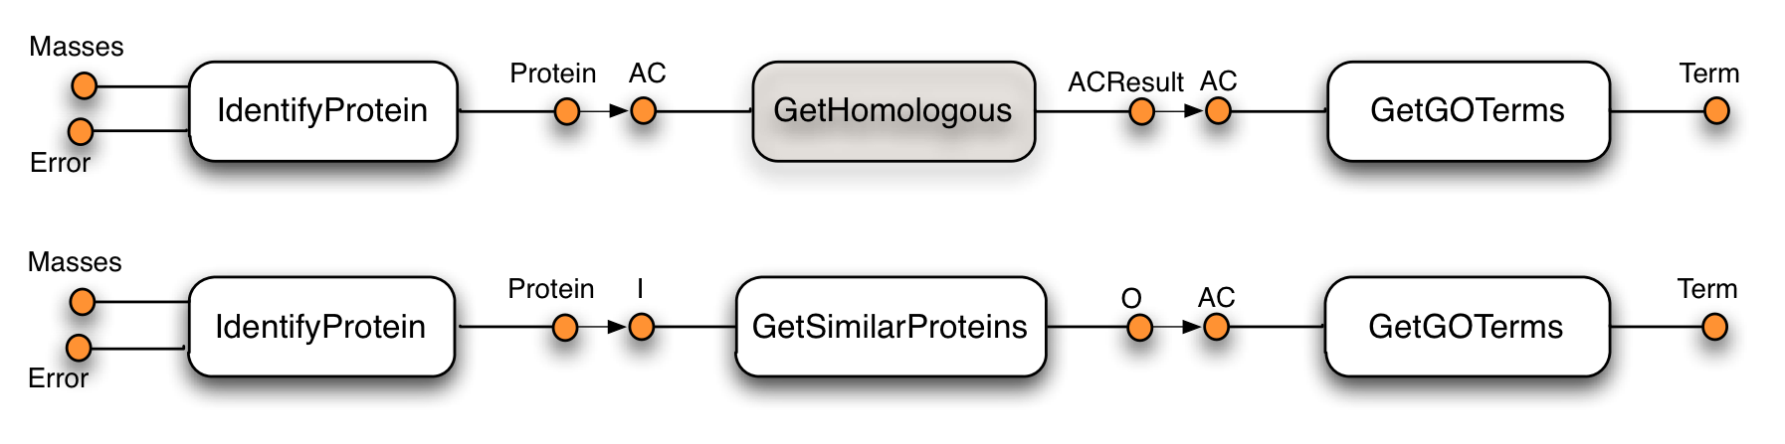
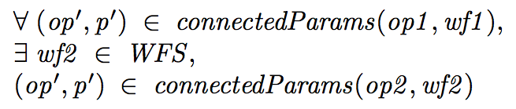
Parameter Compatibility
Formally, let wf1 be a workflow in which the operation op1 is unavailable. The operation op2 can replace the operation op1 in terms of its inputs and outputs if:
Notes:
Consider the existence of the workflow illustrated on the slide.
The operation GetSimilarProteins in this workflow is connected to both IdentifyProtein and GetGOTerm which are also connected to the unavailable operation GetHomologous. If the data links in this workflow are free from mismatches then the input and the output of GetSimilarProtein are respectively compatible with the output of IdentifyProtein and the input of GetGOTerm in that they can be connected within a workflow.
Notice that in addition to the condition stated above, all the mandatory input parameters of the substitute must be connected within the workflow in which it is used. For example, if the operation GetSimilarProteins had a mandatory input other than (GetSimilarProteins , i ), then it would have not been possible to use it as a replacement for the GetHomologous operation.

Slide 46
Task Compatibility
In addition to the compatibility in terms of inputs and outputs, we have to check that the candidate substitute performs a task compatible with that of the unavailable operation.
To perform this test, we exploit the following observation. An operation op2 is able to replace the operation op1 in terms of task, if for every possible input instances that op1 is able to consume, op2 delivers the same output as that obtained by invoking op1.
To perform the above test, however, we will have to call the missing operation op1!
A solution that we adopt for overcoming the above problem makes use of workflow provenance logs. These are traces that contain intermediate data that were used as input and delivered as output by the constituent operations of a workflow when enacted.
Notes:
In addition to the compatibility in terms of inputs and outputs, we have to check that the candidate substitute performs a task compatible with that of the unavailable operation. This raises the question as to how we can verify that a candidate su stitute performs a task that is compatible with that of the unavailable operation in the absence of semantic web service annotations. To perform this test, we exploit the following observation. If GetSimilarProteins performs a task compatible with that of GetHomologous, then for the same input, both operations should in principle deliver the same output. Formally, an operation op2 is able to replace the operation op1 in terms of task, if for every possible input instances that op1 is able to consume, op2 delivers the same output as that obtained by invoking op1. To perform this test, however, we will have to call the missing operation op1!
A solution that we adopt for overcoming the above problem makes use of workflow provenance logs. These are traces that contain information about past executions of workflows. More importantly, they contain intermediate data that were used as input and delivered as output by the constituent operations of a workflow when enacted. Example of workflow provenance stores are Janus [15] and PASOA [14]. The rest of this section shows the method we use to verify that a given operation performs a task compatible with that of the missing operation using as input collected workflow provenance logs.

Slide 47
Task Compatibility (cont.)
An operation op2 may be compatible in terms of task with op1 if:
op2 delivers the same results that op1 delivered in past executions, that are logged within provenance logs, when fed using the same input values.
Notice that we say may be compatible. This is because we may not be able to compare the outputs obtained for every possible input value of the operation op1.
Notes:
Notice that we say may be compatible. This is because we may not be able to compare the outputs obtained for every possible input value of the operation op1. Provenance logs is likely to provide only a subset of possible input values that the unavailable operation was able to consume and, therefore, may not include values for which the candidate operation delivers results that are different from those obtained using the unavailable operation.

Slide 48
Relaxing Substitutability Conditions
The condition that we have described for checking the suitability of an operation as a substitute for another one may be stronger than is required in practice.
There are various parameter representations that are adopted in bioinformatics.
Because of representation mismatch, a service operation that performs a task similar to the missing operation may be found to be unsuitable.
Notes:
There are various text representations that are adopted in bioinformatics. For example, a biological sequence can be formatted according to Fasta, Ensemble, Uniprot, gff formats to cite a few. Because of representation mismatch, a service operation that has input (resp. output) parameters that belong to the same semantic domain as those of the missing operation, and that performs the same task as the missing operation, may be found not to be a suitable substitute.

Slide 49
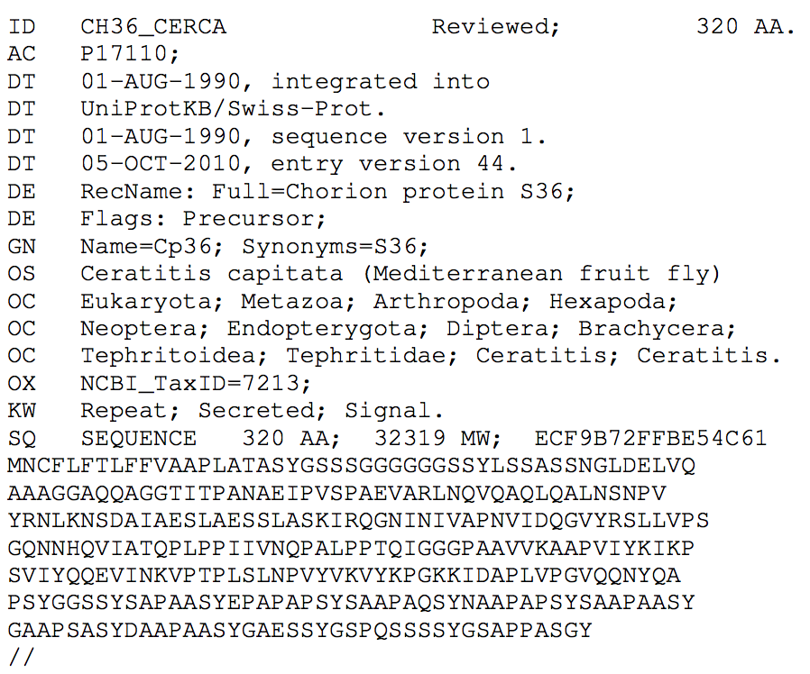
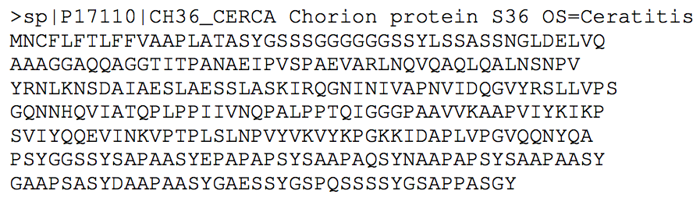
Example of values delivered by two operations using the same input value
Value2
Value1
CosSym(value1,value2) = 0.007

Slide 50
Relaxing Substitutability Conditions
To overcome this problem, we use a two step process when comparing the values of parameters:
Given a parameter value, we derive its representation.
If the representation is associated with a key attribute (identifier), extract the value of such an attribute
If two parameter values are associated with identifiers, then they are compared by comparing their identifiers.
Notes:
To overcome the above problem, we use a two-step approach in which given a parameter value, we first try to derive its representation. This step is performed using a recognizer that is able to recognize widely popular biological formats. Some representations contain key attributes that can be used to uniquely identify a biological entry that is represented by the parameter instance. This is the case for example for biological sequence records. If that is the case, the recognizer extracts the value of such an attribute. For example, the attribute used to identify entries formatted using the Ensembl format is AC, where as in Fasta format, the identifier is specified in the first line using the regular expression sp|identifier|.

Slide 51
Example of values delivered by two operations using the same input value
Value2
Value1
Fasta Format
Uniprot Format

Slide 52
Detecting Duplicates in Workflow Results
Scientific Workflow Reproducibility

Slide 53
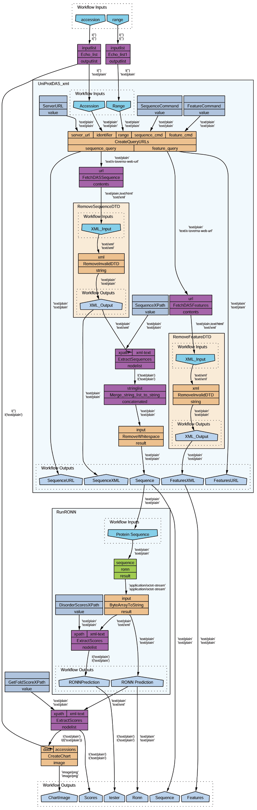
Scientific Workflows
Scientific workflows are increasingly used by scientists as a means for specifying and enacting their experiments.
They tend to be data intensive
The data sets obtained as a result of their enactment can be stored in public repositories to be queried, analyzed and used to feed the execution of other workflows.
Notes:
Workflows are increasingly used by scientists as a means for specifying and enacting their experiments. Such workflows are often data intensive [5]. The data sets obtained by their enactment have several applications, e.g., they can be used to understand new phenomena or confirm known facts, and therefore such data sets are worth storing (or preserving) for future analyzes.

Slide 54
Duplicates in Workflow Results
The datasets obtained as a result of workflow execution often contain duplicates.
As a result:
  The analysis and interpretation of workflow results may become tedious.
  The presence of duplicates also unnecessarily increases the size of workflow results.
Notes:
Because of the exploratory nature of research investigations, the datasets obtained by workflow executions often contain duplicates data records. Indeed, scientists tend to enact the same workflow several times using the same or overlapping datasets, which gives rise to duplicates in workflow results.
Typically, the duplicate records generated as a result are assigned different identifiers by the workflow engine. This yields the following undesirable outcomes: i)- The analysis and interpretation of workflow results may become cumbersome and tedious, as it is up to the scientist to identify the data records that are semantically identical, to eventually draw scientific conclusions. ii)- Moreover, the presence of duplicate records unnecessarily increases the size of datasets within workflow results repositories.
To address this problem, existing duplicate record detection can be used.

Slide 55
Duplicate Record Detection
Research in duplicate record detection has been active for more than three decades.
  Elmagarmid et al., 2007 conducted a comprehensive survey of the topics.
We do not aim to design yet another algorithm for comparing and matching records.
Rather, we investigate how provenance traces produced as a result of workflow executions can be used to guide the detection of duplicate records in workflow results.
Ahmed K. Elmagarmid, Panagiotis G. Ipeirotis, and Vassilios S. Verykios. Du-plicate record detection: A survey. IEEE Trans. Knowl. Data Eng., 19(1):1–16,2007.
Notes:
Duplicate record detection is a well-studied problem. Elmagarmid el at. Conducted a comprehensive survey of the topics.
Broadly speaking, many similarity and machine learning techniques have been developed by researchers to identify when two records refers to the same entity.

Slide 56
Preliminaries: Data-Driven Workflows
A data driven workflow can be defined as a directed graph:
A node represent an analysis operation, which has a set of input and output parameters.
The edges are dataflow dependencies:
Notes:
A data driven workflow is a directed acyclic graph.
A node xop,Iop,Oopy P N represents an analysis operation op, which can be implemented as a Java program, a Perl script or provided by a third party web service, has a set of ordered input parameters Iop, and has a set of ordered output parameters Oop.
The edges are data flow dependencies specifying how the data records generated by a given operation are used by the succeeding operation(s) within the workflow. An edge xxop, oy, xop1, iyy P E is a pair that connects the output o of the op operation to the input i1 of another operation op1.

Slide 57
Preliminaries: Provenance Trace
The execution of workflows gives rise to provenance trace, which we capture using two relations.
Transformation: to specify that the execution of an operation took as input a given ordered set of records and generated another ordered set of records.
Transfer: to specify transfer of records along the edges of the workflow.
Notes:
For exposition sake, we use the following notation, where InB denotes the input bindings of the operation op, and OutB denotes the output bindings of the operation op.

Slide 58
Provenance-Guided Detection of Duplicates: Approach
To guide the detection of duplicates in workflow results we exploit the following fact:
An operation that is known to be deterministic produces identical output bindings given the same input binding.

Slide 59
Provenance-Guided Detection of Duplicates: Example
i
o
i’
o’
IdentifyProtein
GetGOTerm
R_{i}
R_{o}
R’_{i}
R’_{o}
The set of records R_{i} that are bound to the input parameter of the starting operation are compared to identify duplicate records.
The result of this phase is a partition of disjoint sets of identical records.
Notes:
Given a workflow and the provenance trace obtained by its enactment multiple times, the records that are bound to the input parameter of the starting operation are compared to identify duplicate records.

Slide 60
Provenance-Guided Detection of Duplicates: Example
i
o
i’
o’
IdentifyProtein
GetGOTerm
R_{i}
R_{o}
R’_{i}
R’_{o}
The sets of records R_{o,} R’_{i} and R’_{o} are partitioned into sets of identical records based on the partitioning of R_{i}. For example:
Notes:
Given a workflow and the provenance trace obtained by its enactment multiple times, the records that are bound to the input parameter of the starting operation are compared to identify duplicate records.

Slide 61
Provenance-Guided Detection of Duplicates: Example
In the example just described, the operations that compose the workflow have exactly one input and one output parameter.
  However, the algorithm we developed supports operations with multiple input and output parameters.
Notice that we assumes that the analysis operations that compose the workflow are deterministic. This is not always the case.
  This raises the question as to how to determine that a given operation is deterministic.
Notes:
Given a workflow and the provenance trace obtained by its enactment multiple times, the records that are bound to the input parameter of the starting operation are compared to identify duplicate records.

Slide 62
Verifying The Determinism of Analysis Operations
To verify the determinism of operations, we use an approach whereby operations are probed.
Given an operation op, we select examples values that can be used by the inputs of op, and invoke op using those values multiple times.
If op produces identical output values given identical input values, then it is likely to be deterministic, otherwise, it is not deterministic.
Notes:
Given an operation $op$, we select examples values that can be used by the inputs of $op$, and invoke $op$ using those values multiple times. We then examine the values produced by the operation. If the operation produces identical output values given identical input values, then it is likely to be deterministic, otherwise, it is not deterministic. Note that we say {\em likely to be deterministic}, since an operation may, in certain corner cases, be deterministic for the examples we selected but not for the whole space of legal input values. Note that such tests should be performed continuously over time. Indeed, as we shall explain later on in Section \ref{subsec:empirical}, many analysis operations use underlying data sources in their computation, and, as a result, updates to those sources may break the determinism of those operations. Therefore, tests performed for checking the determinism of operations should be performed over time to determine the window of time during which the operations in a given workflow remain deterministic.

Slide 63
Collection-Based Workflows
To support duplicates detection in collection based workflows we need to be able to:
Identify when two collections are identical
  Two collections R_{i} and R_{j} are identical if they are of the same size and there is a bijective mapping:
  that maps each record r_{i} in R_{i} to a record r_{j} in R_{j} such that r_{i} and r_{j} are identical
Identify duplicates records between two collections that are known to be identical
Identify a bijective mapping that maps every r_{i} in R_{i} to an identical rj in Rj.
Notes:
So far we have considered workflows in which operations take as input an ordered set of records each instance of a given input parameter and produce a set of ordered records each is an instance of a given output parameter. In practice, however, an important class of scientific workflows are collection-based workflows [12]. The analysis operations that constitute such workflows can have inputs (resp. outputs) that consume (resp. generate) a set of records instead of a single record within a single operation invocation.
The algorithm presented in Section 4 needs to be slightly modified to be able to cater for collection-based workflows. In particular, we need to be able to identify when two sets are identical (phase 1), and to identify duplicates records between two sets that are known to be identical (phases 4,7). To illustrate this consider an operation op with an input i that takes a set of records. Given two sets of records Ri and Rj that are bound to the operation op in two different invocations within the provenance trace T , we need to determine whether the two sets Ri and Rj are identical. To do so, we need to compare the records in Ri to the records in Rj . The sets Ri and Rj are identical if they are of the same size, and there is a bijective mapping map : Ri Ñ Rj that maps each record ri in Ri to a record rj in Rj such that ri and rj are identical, i.e., idpri,mapprjqq.Inversely, in phases 4 and 7, given two sets Ri and Rj that are known to be identical, we need to compare the records in Ri with the records in Rj to find a bijective mapping map : Ri Ñ Rj that maps each record ri in Ri to an identical record rj in Rj.

Slide 64
Summarizing Workflows
Scientific Workflow Reproducibility

Slide 65
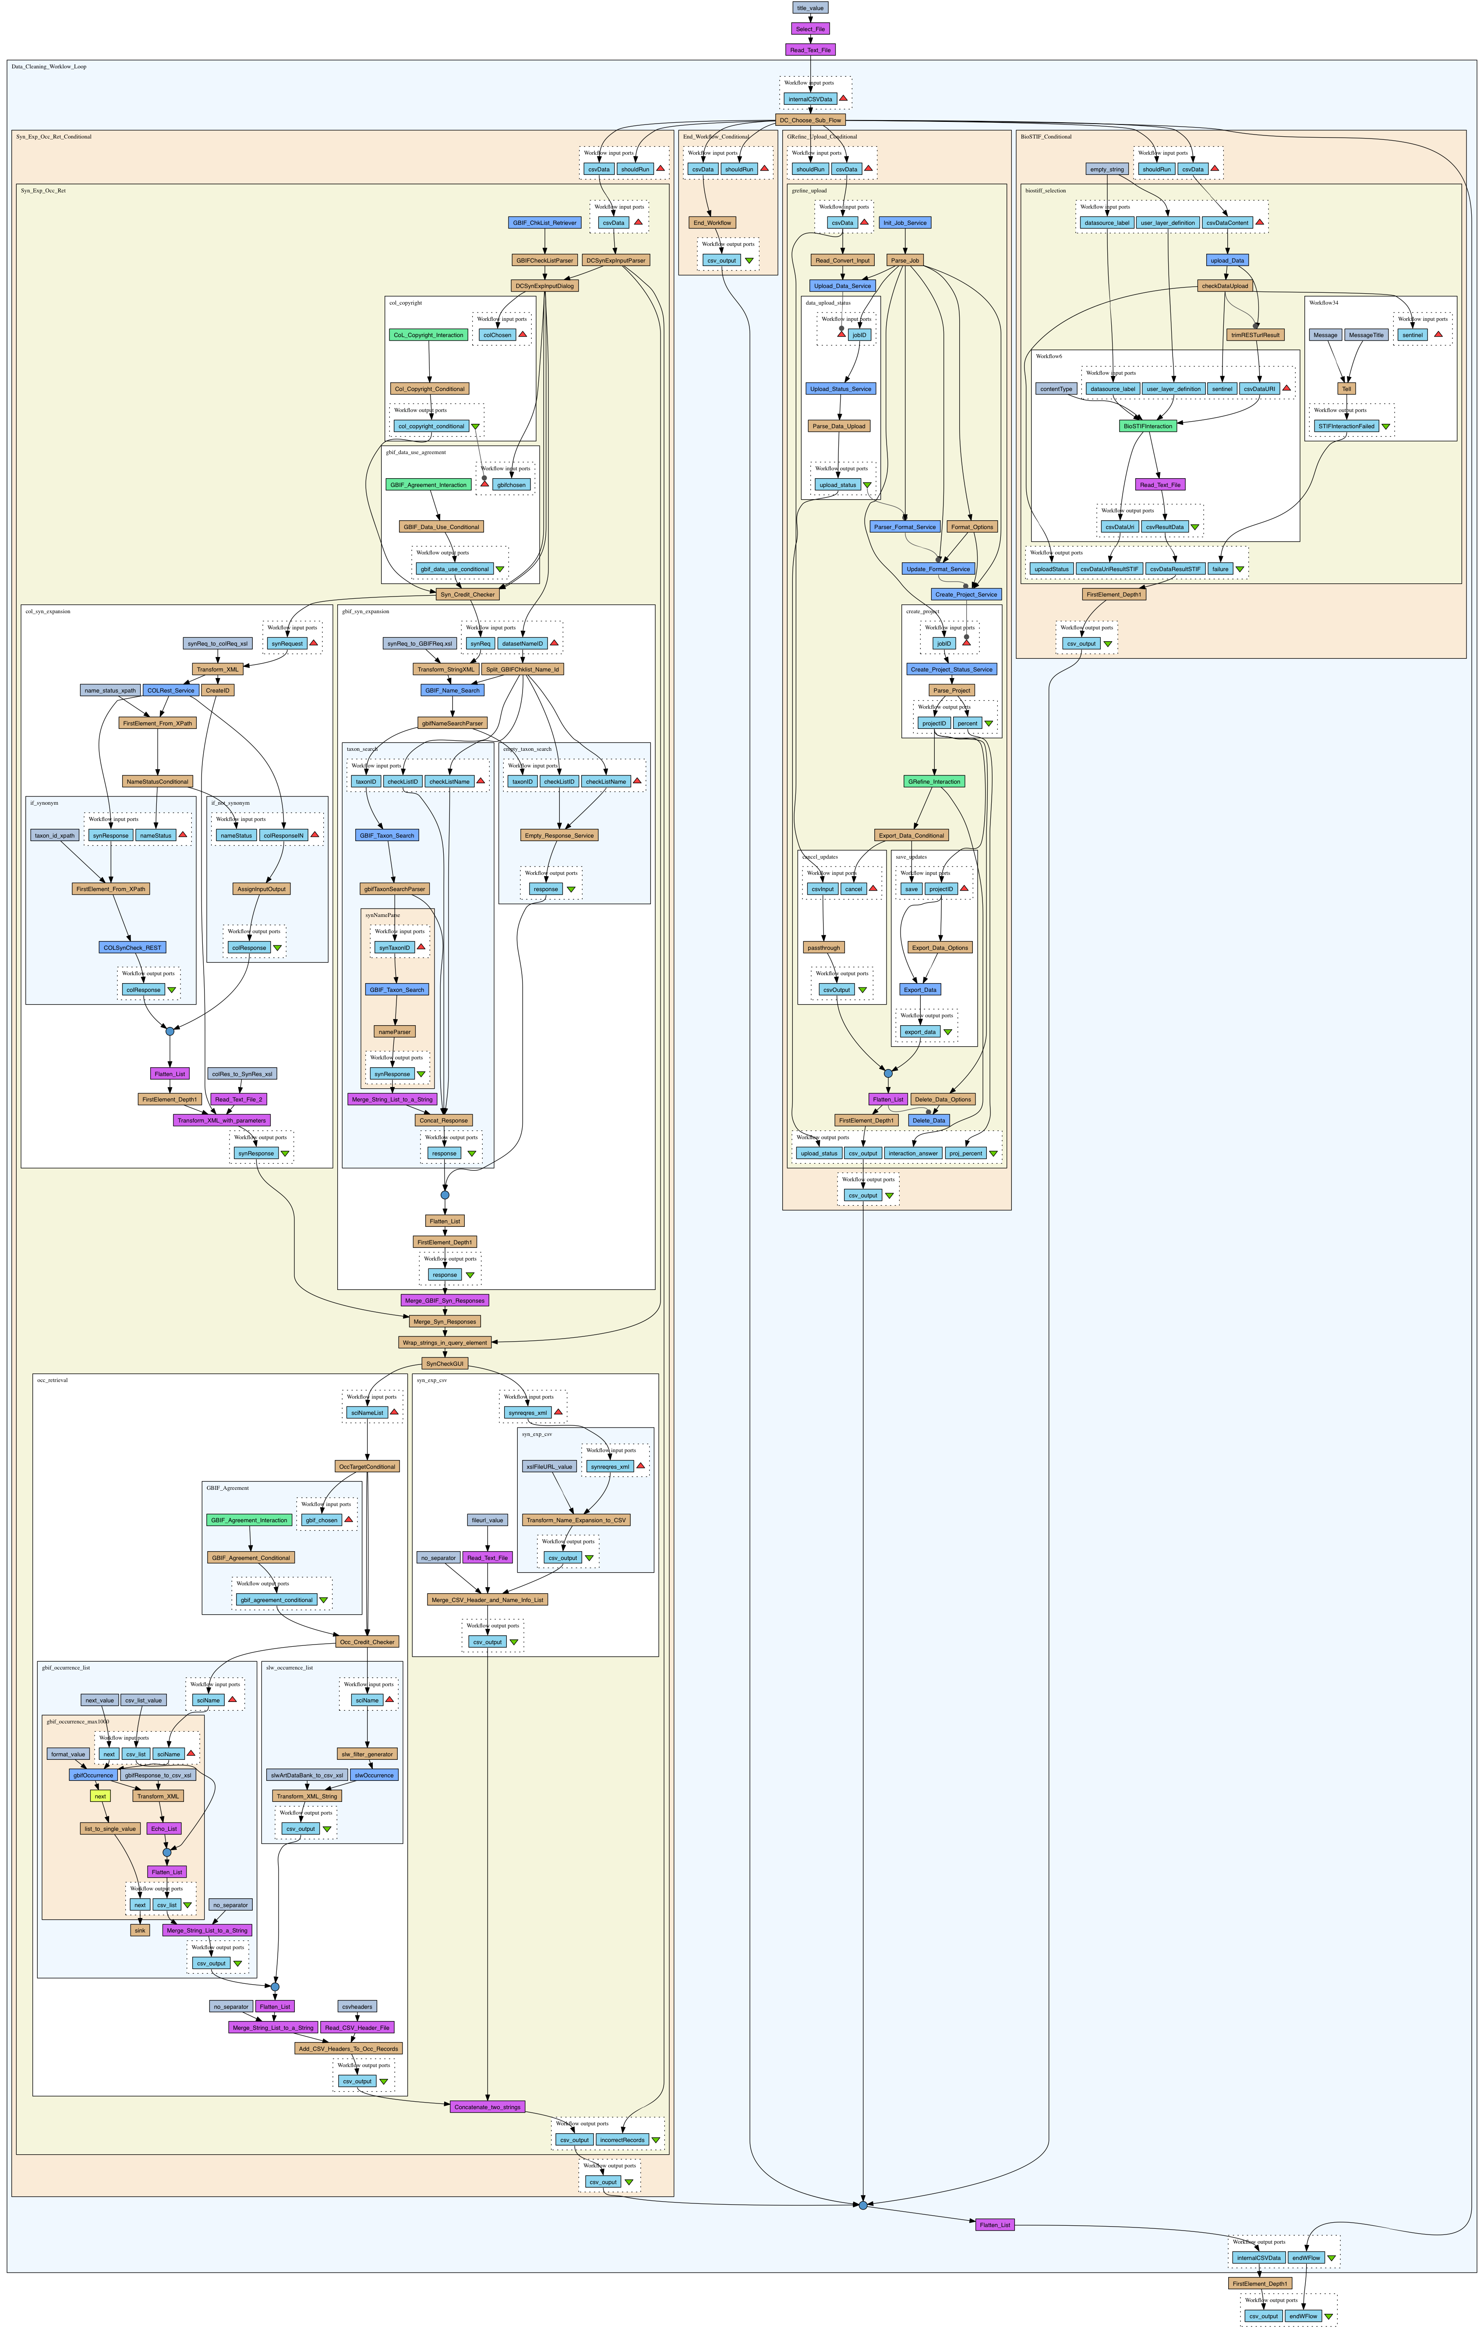
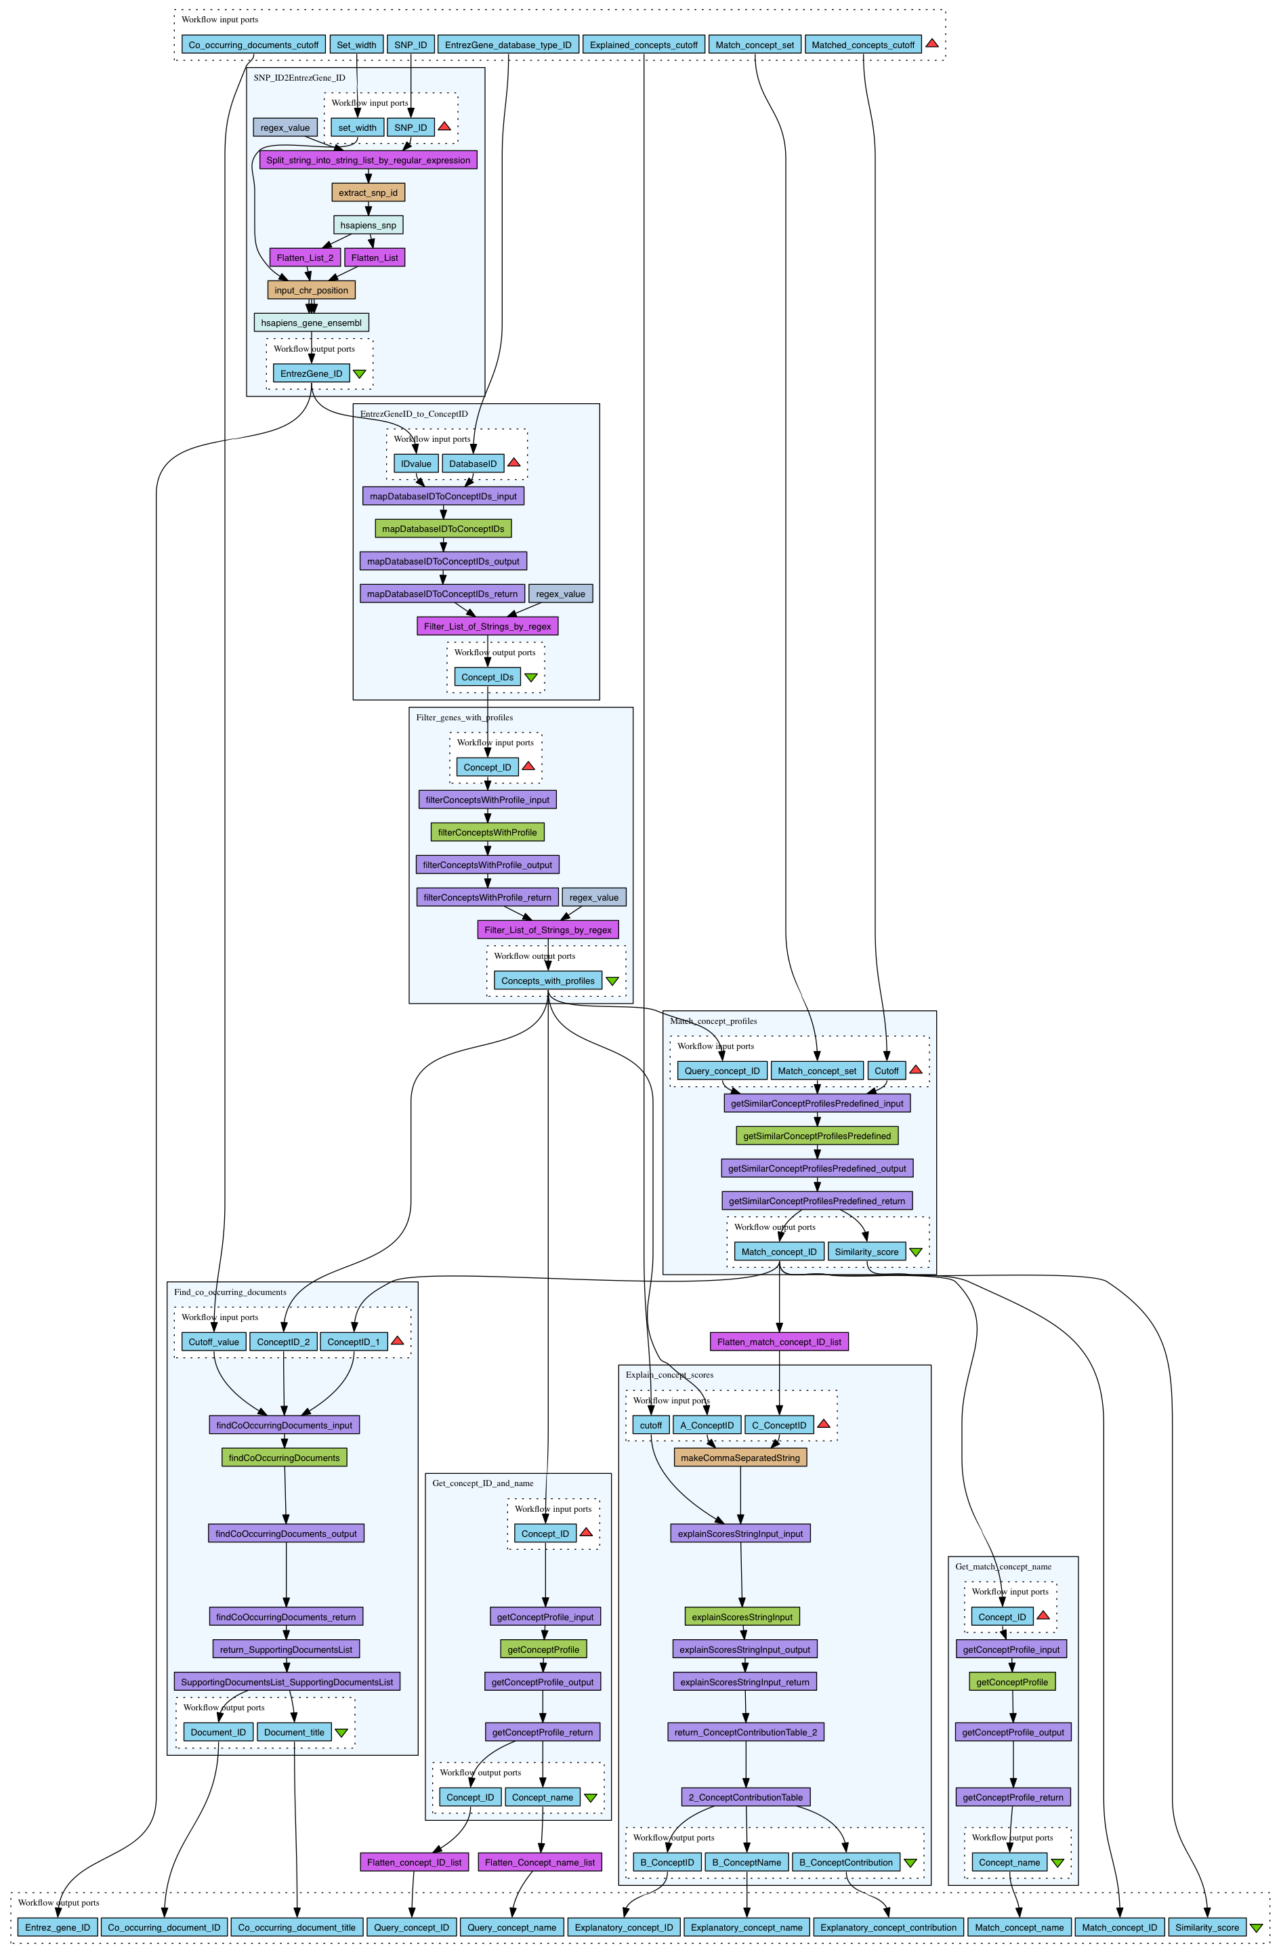
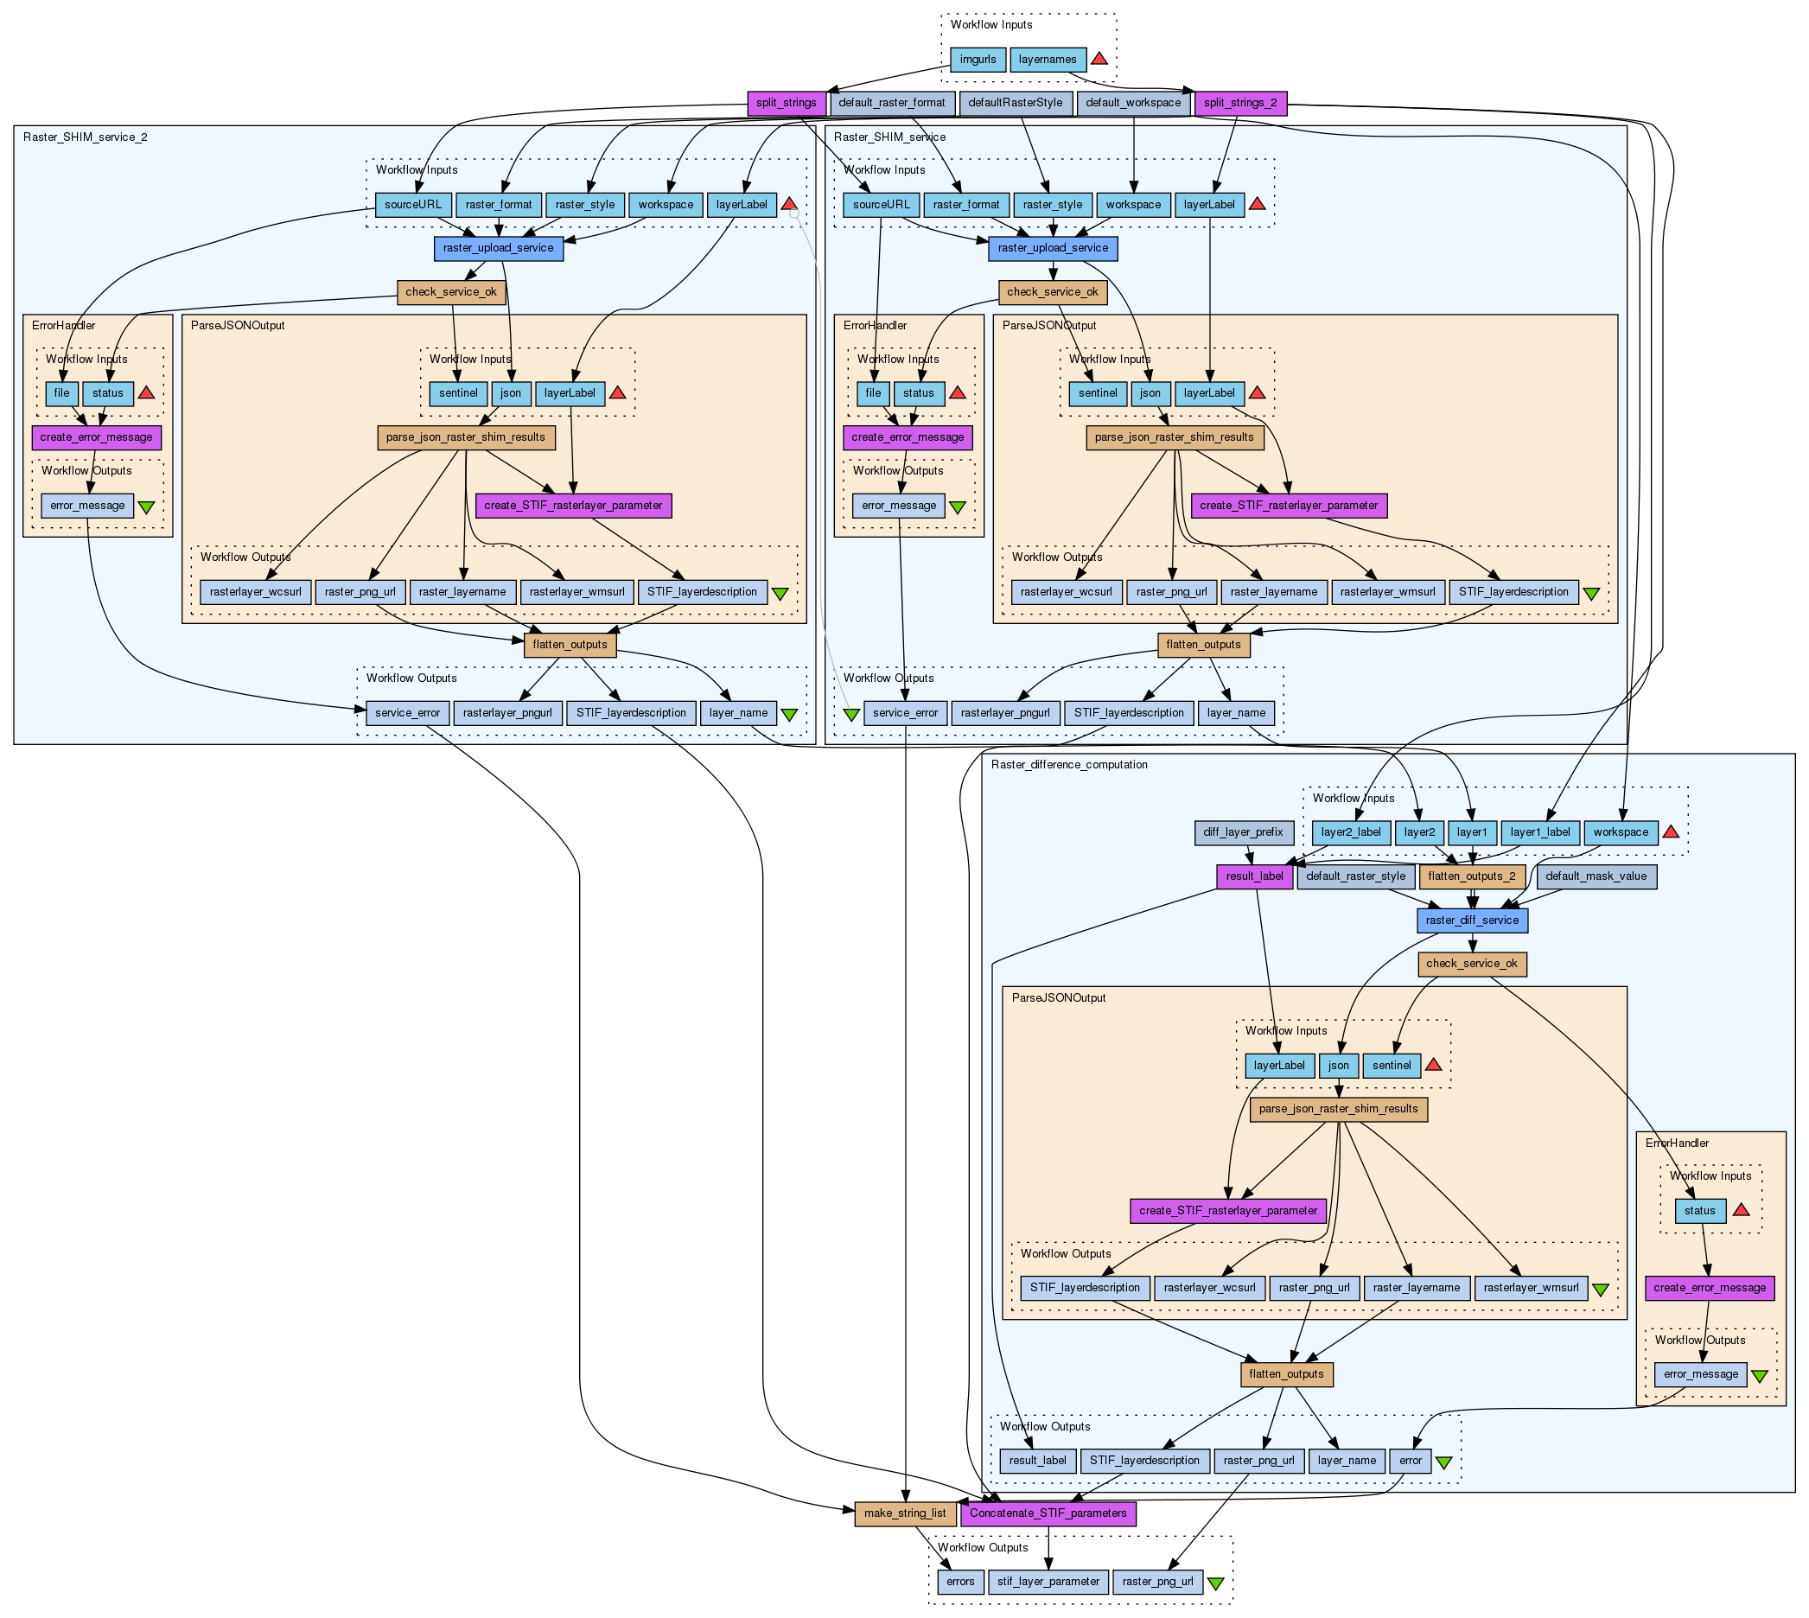
Workflows can get complex!
Overwhelming for users who are not the developers
Abstractions required for reporting
Lineage queries result in very long trails
Notes:
Workflows are typically complex artifacts containing sev- eral processing steps and dataflow links. Complexity is characterized by the environment in which workflows op- erate.
Obfuscation degrades reporta- bility of the scientific intent embedded in the workflow. Complex workflows combined with the faithful collection of execution provenance for each step results in even more complex provenance traces containing long data trails, that overwhelm users who explore or query them [3], [1].

Slide 66
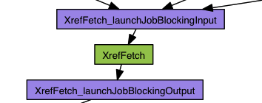




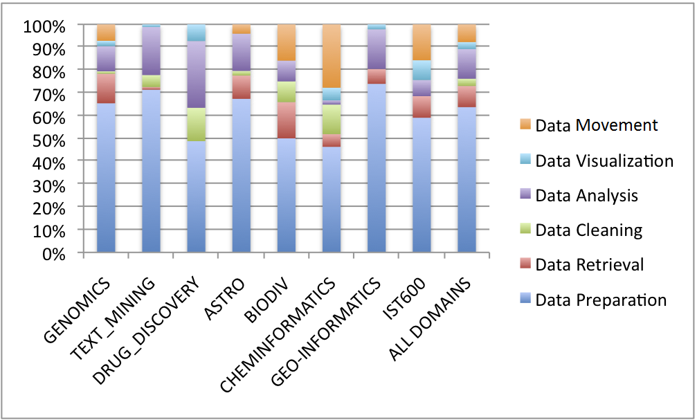





Reason and extent of complexity
a.k.a. Shims
Dealing with data and protocol heterogeneities
Local organization of data
D. Hull et al
~ 60%
Garijo D., Alper. P., Belhajjame K. et al
Notes:
Workflows that collate datasets and tools from 3rd- party autonomous providers contain several adapter steps for handling format and protocol heterogeneities [9][8]. Meanwhile workflows that perform analytics over local(ized) data typically contain several steps dedicated to organization and pre-processing of data. We have shown in a previous study [8] that these mundane operations account for up to 60% of the steps that compose workflows. These steps dealing with the technical detail of resource access or data organization obfuscate the scientifically significant/critical operations of the workflow.

Slide 67
Static Ways To Tackle Complexity
Process-Wise and Data-Wise abstractions
Sub-workflows
  Not always a significant unit of function (e.g. aesthetic purposes)
Bookmarked data links
  Cluster the output signature
  Further complicates workflow
Components
  Library dependent
Notes:
Lack of effective simplification solutions have led sci- entists to devise their own ways to cope with complexity. These manual abstraction solutions have the disadvantage of being hard-coded into the workflow design and may not simultaneously cater for different aspects of complexity, as we shall analyze in this paper.
We observe that there are two dimensions along which workflows can be abstracted, 1) process-wise, where a simplified view of the process encoded in the workflow is given and 2) data-wise, where significant data products (in- termediary or final) that a workflow generate is to generate are pinpointed. Scientists perform workflow abstractions in the following ways:
Grouping operations into subworkflows. Subworkflows are a design construct for developing modular workflows, which is an established best practice in workflow development [8]. The major driver for sub-workflows is to create modules of significant or re-usable function within or across workflows. In practice, however, subworkflows can also be used for purposes other than functional modularity. For example, the workflow illustrated in Figure 1 contains a subworkflow that simply concatenates two parameters. Such subworkflows are created for aesthetic purposes to simplify the design, as opposed to abstracting significant functionality.• Sinking ports expected to hold significant intermediary data artifacts to workflow outputs. The links tagged with stars in Figure 1 correspond to such sinking activity. We refer to these as “bookmarked data links” in the rest of the paper. Bookmarking is done when the user wants to report significant side-products alongside the intended outputs of the workflow, and encodes this as part of the workflow design. Hard-coded bookmarking is a poor practice for workflow design, as it clutters the output signature of the workflow. Moreover, it creates more complexity process- wise while trying to provide abstract data-wise.• Using libraries of components engineered to work to- gether. Several workflow systems provide libraries of components that have well-defined and interoperable-by-design invocation interfaces. By solely using modules from such libraries, compact workflows with little/no data adapter operations can be devised. This approach, however, is highly dependent on those curated libraries, and as soon as one tries to incorporate resources from other contexts or libraries, then one needs data adaptation and organization.

Slide 68


Our Solution: Workflow Description Summaries
A graph model for representing workflows
Graph re-write rules for summarization
IF <performs certain function> THEN <re-write WF graph>
motifs
reduction-primitives
Notes:
In this paper we propose the generation of workflow description summaries to tackle complexity in experiment reporting scenarios. Our approach has the following charac- teristics and contributions: We focus on data-driven work- flows, which is the paradigm supported by most scientific workflow systems. We provide a graph based model for representing data-flows. We use graph re-writing as the method of summarization. We re-write workflow graphs with rules built on 1) semantic annotations that depict the data- oriented function of operations within workflows, which we call motifs, and 2) a set of workflow reduction primitives that we introduce. Rules associate motifs, and combina- tions of thereof, with reduction actions that specify the abstraction operation to be performed. Re-write rules capture scientist-specified strategies on how summarization should occur.
Based on observations on workflows from the largest public repository of workflows, we elaborate two sample strategies that aim to abstract out “mundane” data adapter and organizer steps in workflows. In order to highlight the characteristic of primitives and asses our approach, we conducted an experiment where we summarized 30 real-world scientific workflows. Summarization is done by using the two sample strategies and we compare the results against summaries that are manually generated by the workflow designers as the ground truth.

Slide 69
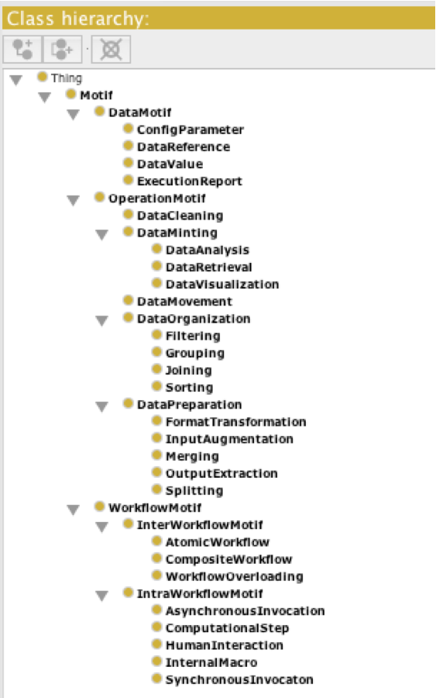
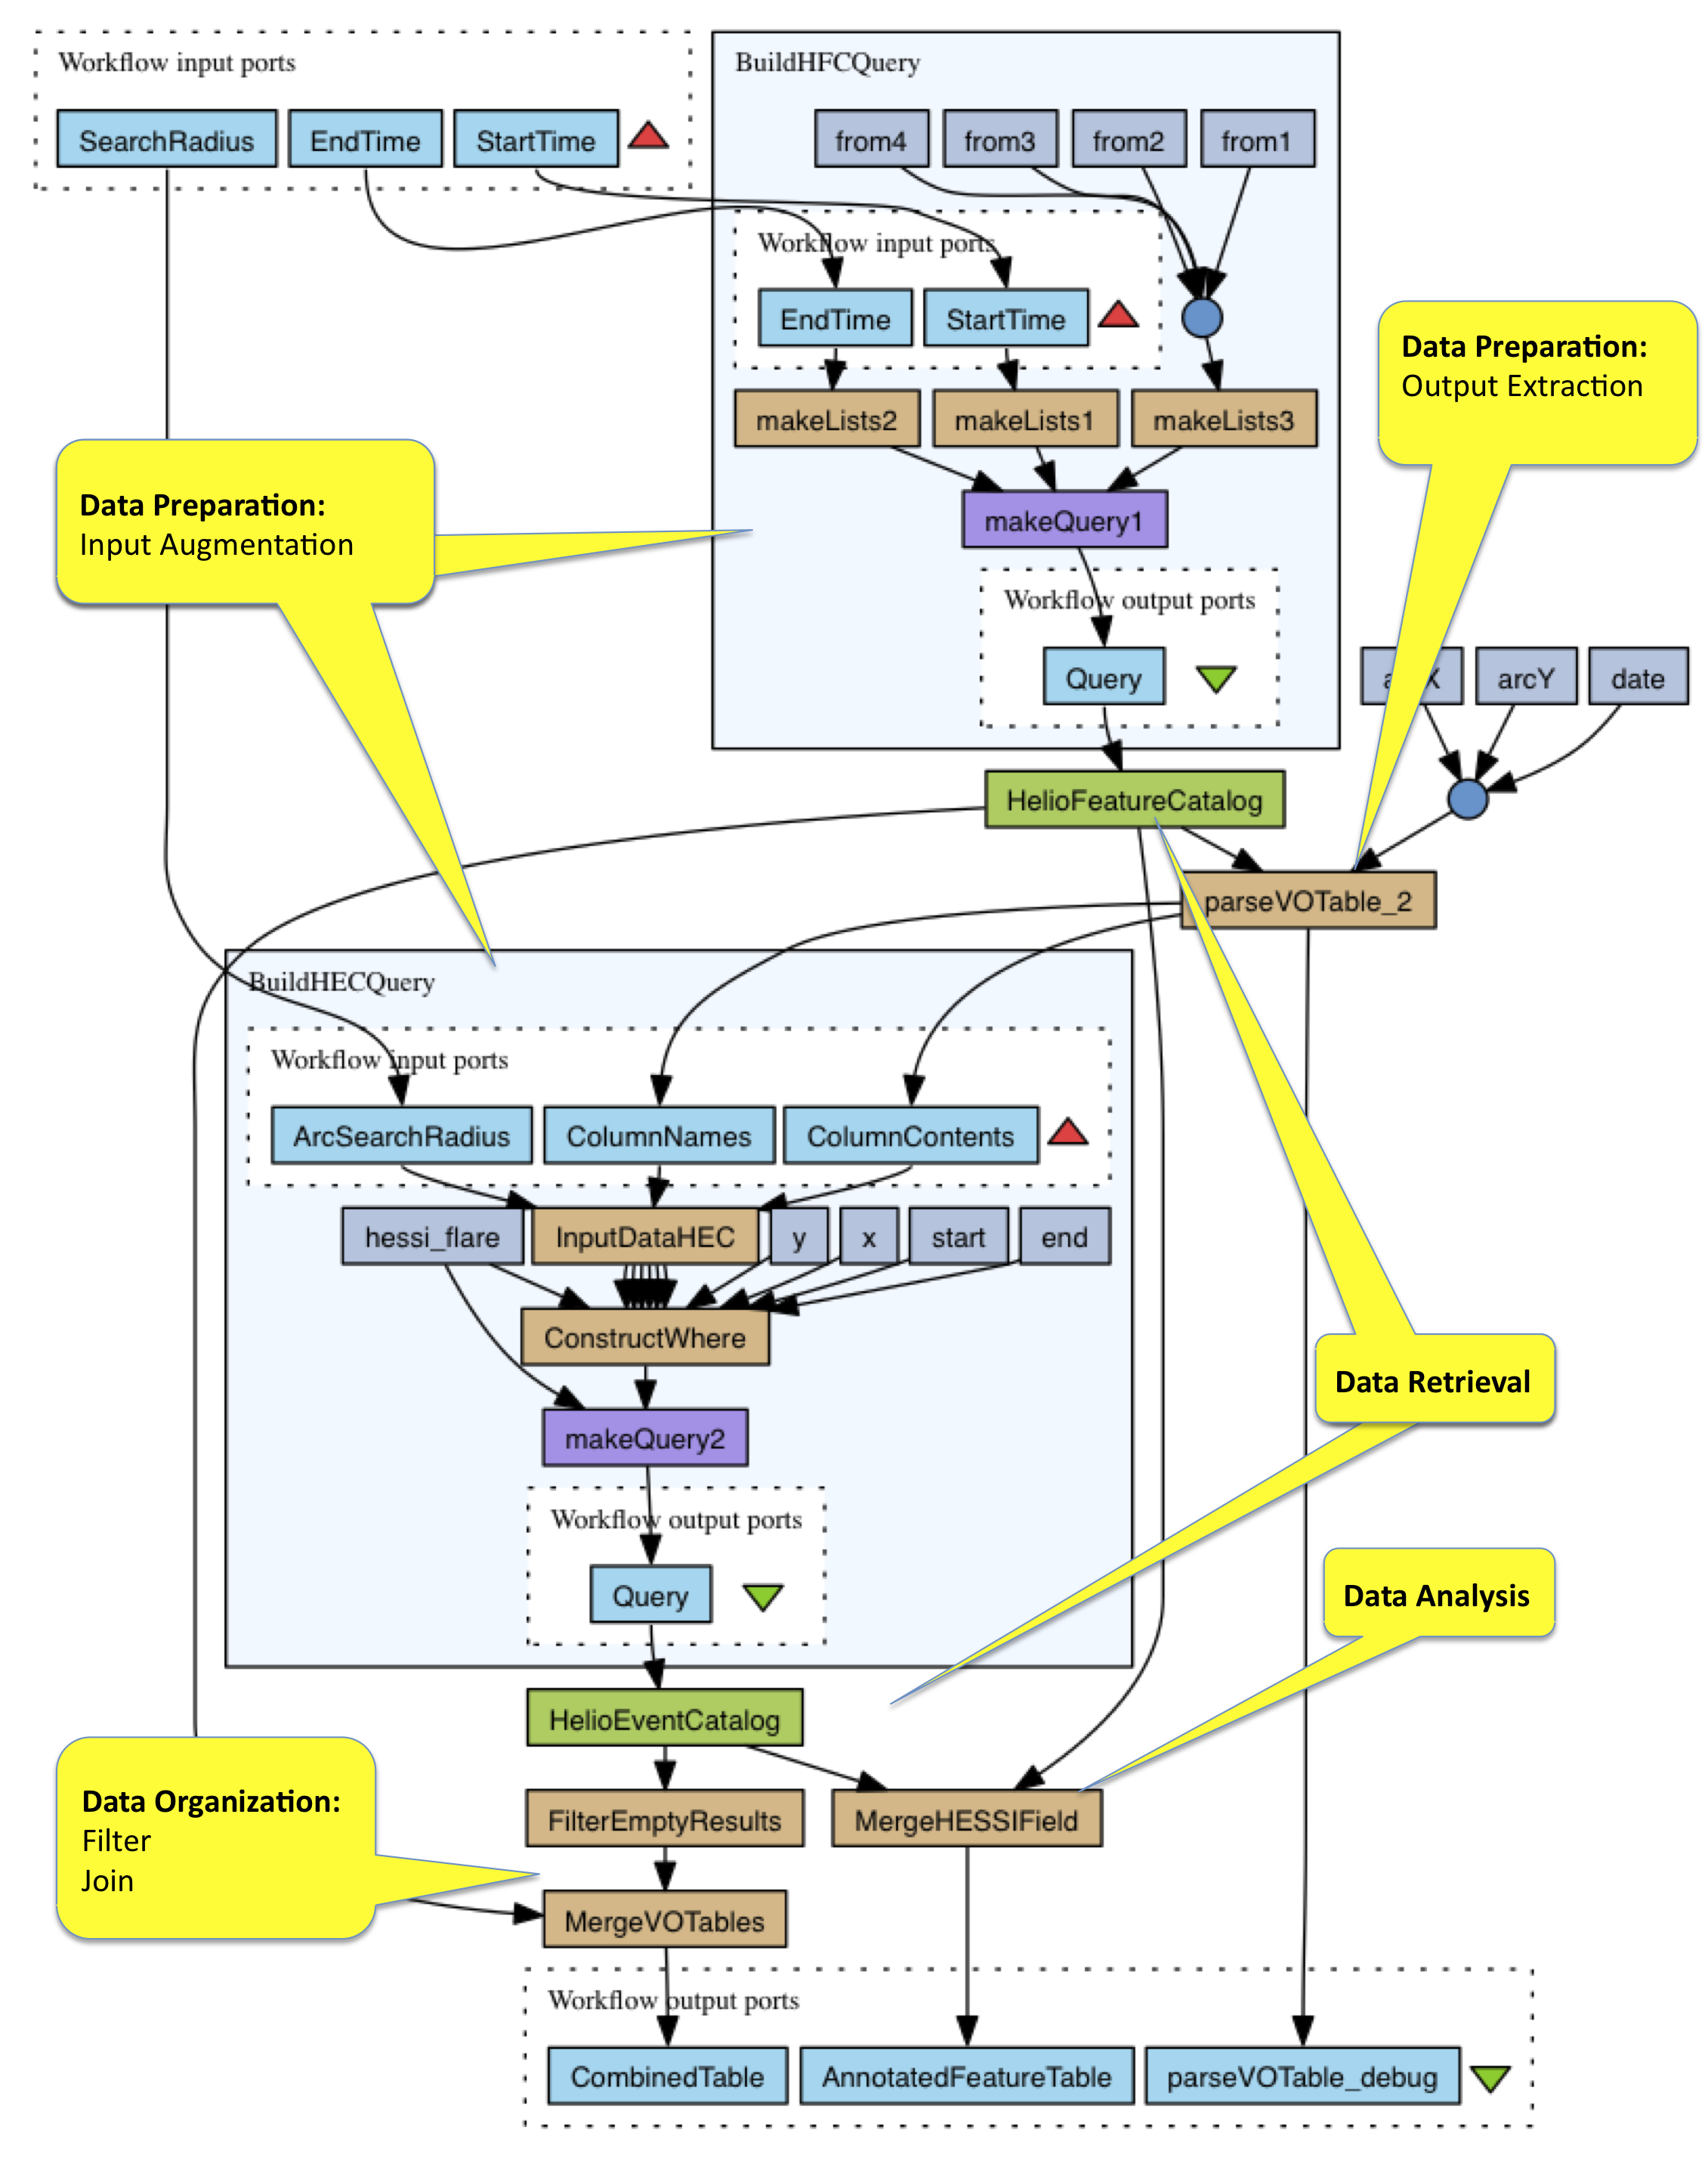
PART-1: Scientific Workflow Motifs
Domain Independent categorization
  Data-Oriented Nature
  Resource/Implementation-Oriented Nature
Captured In a lightweight OWL Ontology
http://purl.org/net/wf-motifs
Notes:
Scientific Workflow MotifsAt the heart of our approach lies the exploitation of information on the data processing nature of activities in workflows. We propose that this information is provided through semantic annotations, which we call motifs. We use a light-weight ontology, which we developed in previous work [8] based on an analysis of 200+ workflows (Ac- cessible: http://purl.org/net/wf-motifs). The motif ontology characterizes operations wrt their Data-Oriented functional nature and the Resource-Oriented implementation nature. We refer the reader to [8] for the details, here we briefly introduce some of the motifs in light of our running example. • Data-Oriented nature. Certain activities in workflows, such as DataRetrieval, Analysis or Visualizations, perform the scientific heavy lifting in a workflow. The gene annotation pipeline in Figure 1) collects data from various resources through several retrieval steps ( see “get enzymes by gene” , “get genes by enzyme” opera- tions). The data retrieval steps are pipelined to each other through use of adapter steps, which are categorized with the DataP reparation motif. Augmentation is a sub-category of preparation operations. Augmentation decorates data with resource/protocol specific padding or formatting. (The sub- workflow “Workflow89” in our example is an augmenter that builds up a well formed query request out of given parameters.) Extraction activities perform the inverse of augmentation, they extract data from raw results returned from analyses or retrievals (e.g. SOAP XML messages). Splitting and Merging are also a sub-category of data preparation, they consume and produce the same data but change its cardinality (see the “Flatten List” steps in our example). Another general category is DataOrganization activities, which perform querying and organization func- tionsoverdatasuchas,F iltering,J oiningandGrouping. The “Remove String Duplicates” method in our example is an instance of the filtering motif. Another frequent motif is DataMoving. In order to make data accessible to external analysis tools data may need to be moved in and out of the workflow execution environment such activities fall into this category (e.g. upload to web, write to file etc). The “Get Image From URL 2” operation in our genomics workflow is an instance of this motif.• Resource-Oriented nature, which outlines the implemen- tation aspects and reflects the characteristic of resources that underpin the operation. Classifications in this category are: Human − Interactions vs entirely Computational steps, Statefull vs Stateless Invocations and using Internal (e.g. local scripts, sub-workflows) vs External (e.g. web service, or external command line tools) computational artifacts. In our example, all data retrieval operations are realized by external, stateless resources (web services), whereas all data preparation operations are realized with

Slide 70
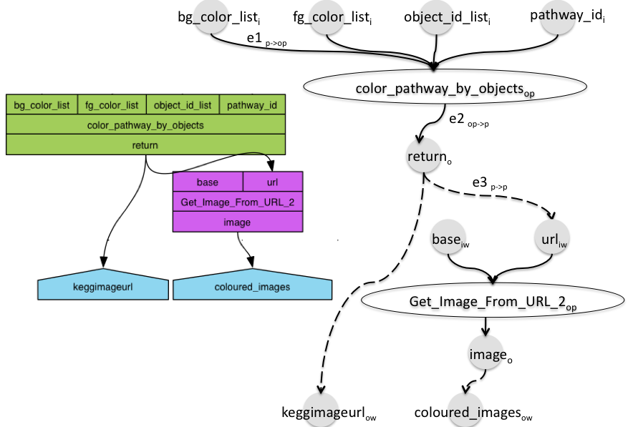
A graph model of data-driven workflows
Pure Dataflows
W= <N,E>
Operation and Port Nodes
N = (N_{op} U N_{p})
Dataflow edges
E = (E_{op➔p} U E_{p➔p} U E_{p➔op} )
Notes:
We address “pure” data flows, i.e. those, in which the order of execution is determined entirely by the availability of data rather than any explicit control-flow constructs (e.g. loops, conditionals).Definition 1. We define a data-driven workflow as a directed acyclic graph (DAG) using the following pair W = ⟨N,E⟩, where N is a set of nodes representing the operations that constitute the workflow and the input and output ports of such operations: N = (NOP ∪ NP ). NOP nodes represent analysis operations in the workflow.The set of ports NP is composed of four sets, depending on whether the port is an input or output and whether it belongs to an operation or is a source/sink port of the entire workflow:NP=(NI∪NO∪NIW∪NOW).Nodes are connected using three types of edges: E = (EP −>OP ∪ EOP −>P ∪ EP −>P ), where EP −>OPconnect input ports to the operations they belong to, EOP−>P connect operations to their output ports, and EP −>Pconnect the output port of an operation to the input port of a following operation. In Figure 2 we provide a mapping from the fragment of our genomics workflow to the graph representation, depicting operation nodes (white ellipses), port nodes (gray circles). (Not depicted in this figure, is an inferred influence relationship from each input of an operation to each output the operation. This relation is not utilized in graph re- writing but is used to query workflow descriptions and their summaries).Definition 2.

Slide 71
Motif annotations over operations
DataRetrieval
DataMovingl
motifs(color_pathway_by_objects) = {m1:DataRetrieval}
motifs(Get_Image_From_URL_2) = {m2:DataMoving}
Notes:
A data-flow decorated with motif annota- tions is 3-tuple: W = ⟨N,E,motifs⟩, where motifs is a function that maps each graph node n ∈ N, be it an operation or port, to its motifs. Operation nodes could have motif annotations from operation, resource perspectives, and port nodes can have annotations from the data perspective (omitted in this paper due to space limitations).As an example, we illustrate below two motif annotations of two operations in our running example. It is worth mentioning that a given node can be associated with multiple motifs.motifs(color pathway by objects) = {⟨m1 : Augmenter⟩} motifs(Get Image From URL 2) = {⟨m2 : DataRetrieval⟩}

Slide 72
PART-2: Workflow reduction primitives
Collapse (Up/Down)
Eliminate

Slide 73
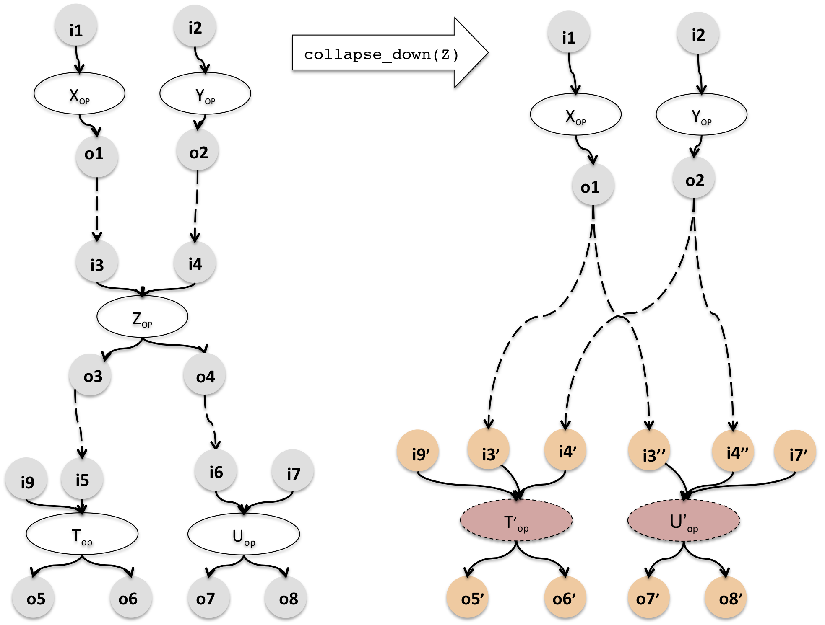
Collapse Down
Notes:
3) Collapse: The collapse primitive is a way to eliminate an operation from the workflow not by introducing indi- rect data links, but by introducing (sometimes redundant, therefore weak) composites. Collapse can be performed either upstream or downstream. We define the function collapse op downstream : ⟨W,op⟩ → ⟨W′,M⟩ as one, which takes an annotated workflow definition, and collapses the designated operation op into all operations that immedi- ately succeed it (a.k.a. collapse hosts) via a direct dataflow link. Collapse is realized by creating composites of op exclusively with each of its hosts (i.e. ignoring relations with other hosts). Upstream collapse is realized by creating composites of op with its immediate predecessors.Motif Behavior: The operation that is collapsed onto another does not carry forward its motifs to the newly generated composite. Whereas the motifs of the operation onto which op is collapsed, i.e. the host propagates its motifs to the composite. Also, the composite inherits the identifier label of the host operation.Constraint Checks: In order for an operation to be collapsed downstream it is required that it is succeeded by at least one operation. The reverse constraint is applicable when collapsing upstream. To prevent against creating cyclic summaries, the host operations on which an operation is to be collapsed shall not co-exist on a data-flow path.Dataflow Characteristic: In case there are more than one host operations, on which collapse will occur the resulting composites are “weak” due to the exclusivity of composi- tions. Collapsing onto multiple hosts creates a redundancy of ports on generated composites and causes the “spreading” of influence relations, where a weak-composite does not provide the full picture of influence relations. For example, in Figure 5, the operation Z is collapsed upstream onto X and Y . The newly created composites X′ and Y ′ are weak in the sense that they separately provide information on some but not all of the inputs that have influenced the generation of e.g. output O3′ and O3′′ which both map to O3.

Slide 74
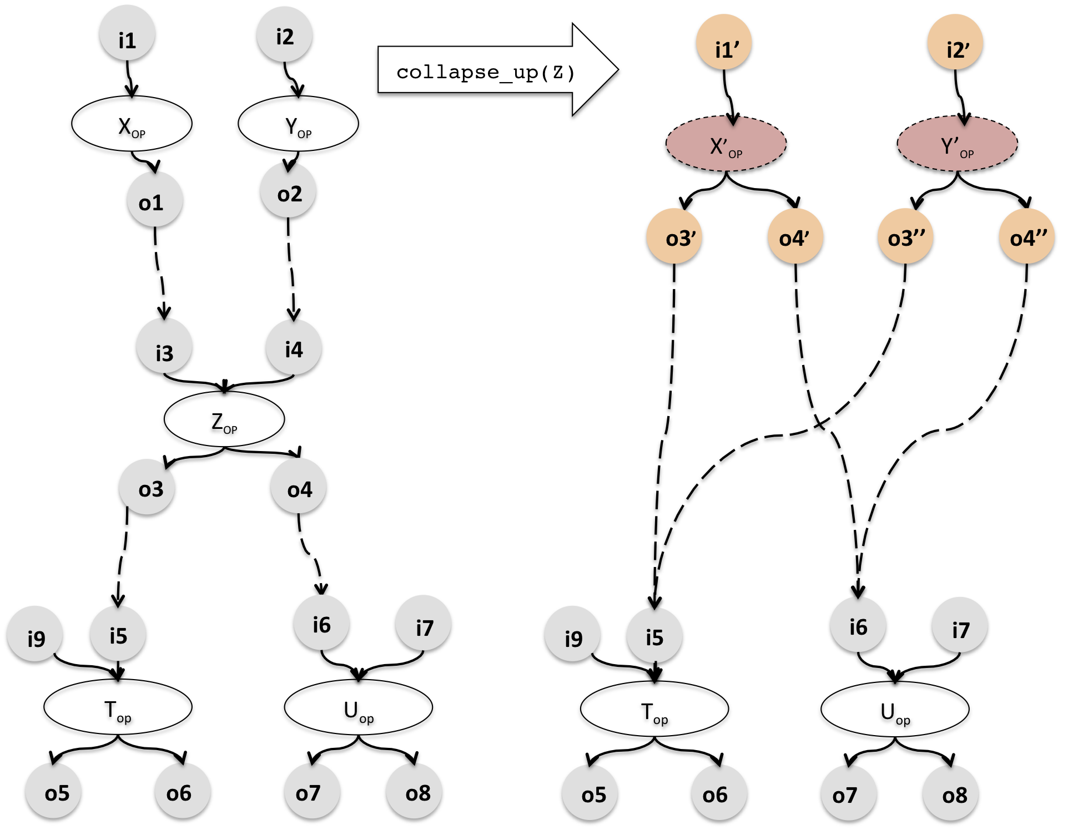
Collapse Up

Slide 75
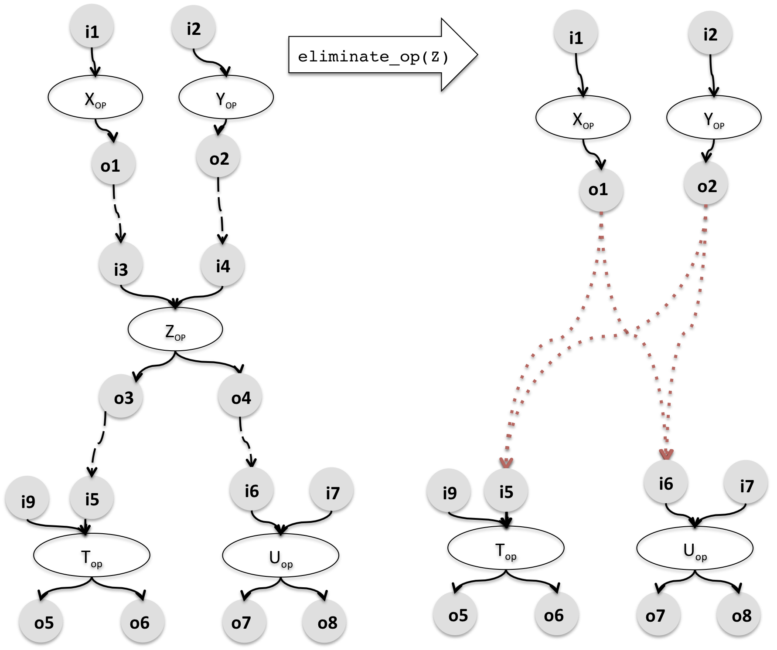
Eliminate
Notes:
2) Elimination: We define the function eliminate op : ⟨W,op⟩ → ⟨W′,M⟩ as one, which takes an annotated workflow definition, and eliminates a designated operation node from it. Elimination results in a set of indirect data links connecting the predecessors of the deleted operation to its successors. The source and target ports of these new indirect links are the cartesian product of the to-be-deleted operation’s inlinks’ sources and its outlinks’ targets. As with other primitives elimination also returns a set of mappings between the ports of the resulting workflow and the input workflow. Motif Behavior: The designated operation is eliminatedtogether with its motifs and these are not propagated to any other node in the workflow graph.Constraint Checks: There are no particular constraint checks for the elimination primitive.Dataflow Characteristic: Within the conventional defini- tion of a workflow, ports are connected with direct datalinks, which correspond to data transfers i.e. the data artifact!-# appearing at the source port is transferred to the target port as-is. In the indirect link case, however, there is no direct data transfer as the source and target artifacts are dissimilar,%&# and some “eliminated” data processing occurs inbetween.

Slide 76
How will rules be put to use
Strategies as a set of rules for summarization
Two sample strategies based on an empirical analysis of workflows
Reporting:
  Process: Significant activities (Retrieval, Analysis, Visualization)
  Data:
    Reduced cardinality
    Stripped of protocol specific payload/formatting
Notes:
In this section, we present two sample strategies for sum- marizing workflow graphs. Such strategies are dependent on the domain in which workflows exist, the characteristics of workflows and the user preferences on summary.
These open-world workflows mainly collate datasets and tools from 3rd party autonomous resource providers. Observations on Taverna workflows and their textual narratives supplied by users pointed that:• Scientists rarely report on data adapter steps within their brief textual summaries of workflows. They choose to mention steps that they deem significant, from a scientific perspective e.g. Data Retrieval, Analysis, Visualization etc. in their summaries.• Scientists also report on the intermediary Inputs and Out- puts of significant steps. This is done either by mentioning data artifacts in text summary or manually bookmarking them to workflow outputs. Bookmarking, however, is done at stages of data processing, where data is in its the mostreporting friendly form such as 1) Data with Reduced Cardinality and 2) Data that is stripped of Implementation Specific Payload. Consequently, we elaborate the following strategies:

Slide 77
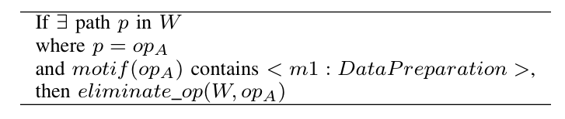
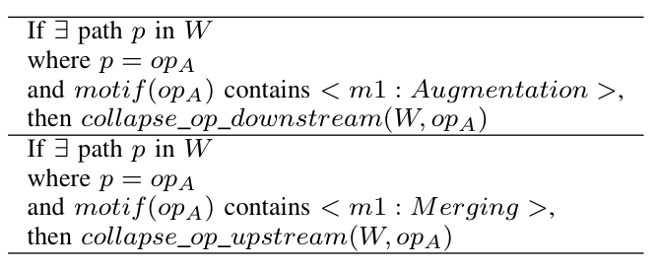
Two sample strategies
By-Eliminate
  Minimal annotation effort
  Single rule
By Collapse
  More specific annotation
  Multiple rules
Notes:
Summary-By-Elimination: Requires minimal amount of annotation effort and operates with a single rule. We have only classified the scientifically significant operations to denote their motifs, and all remaining operations in the workflow are designated to be DataPreparation steps. The following reduction rule is then used to summarize the workflow graph W.
Summary-By-Collapse: Requires annotation of work- flow with motif classes having more specificity and a more fine-grained set of rules. Consequently annotations on data preparation steps are more specific designating what kind of preparation activity is occurring (e.g. Merging, Splitting, Augmentation etc). We use these annotations to remove those data preparation steps from the work- flow by the collapse primitive and collapsing in the di- rection so as to retain the ports that carry more reporting friendly artifacts. We collapse Augmentation, Splitting andRef erenceGenerationoperationsdownstreamastheir outputs are less favored than their inputs, whereas we col- lapse Extraction, Merging, ReferenceResolution and all DataOrganization steps downstream as their outputs are preferred over inputs in a summary. Two rules in this approach are given below:

Slide 78


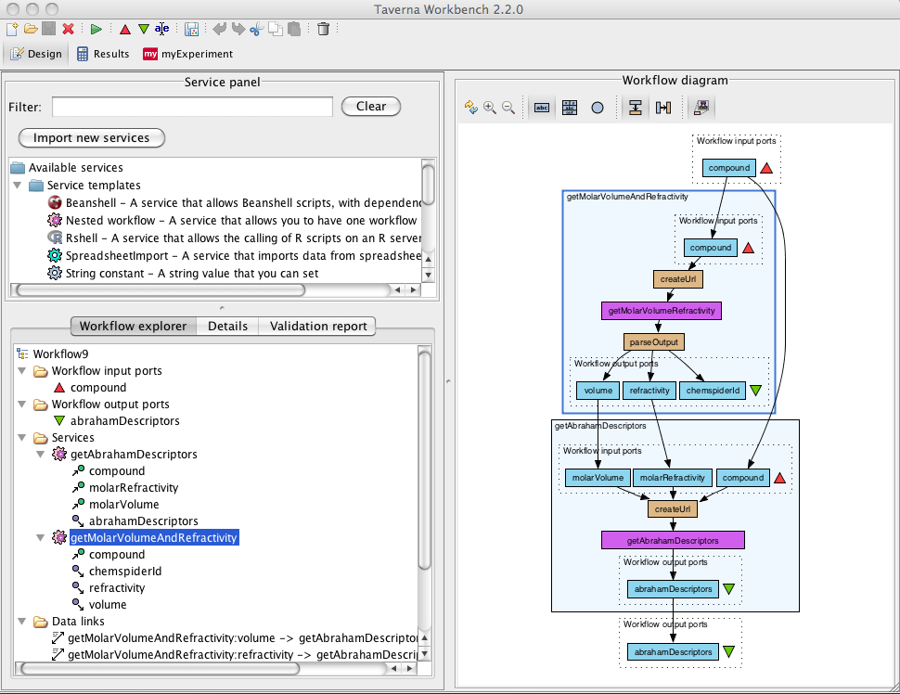



Overall Approach
WF Summary
Workflow
Designer
Summarizer
WF Description
Summarization Rules
Taverna Workbench
Motif Ontology

Slide 79
Analysis Data Set
30 Workflows from the Taverna system
Entire dataset & queries accessible from http://www.myexperiment.org/packs/467.html
Manual Annotation using Motif Vocabulary
Notes:
In our evaluation we annotated the workflow corpusmanually using the motif ontology. The effort that goes into the design of workflows can be significant (up to several days for a workflow). When compared to design, the cost of annotation is minor (as it amounts to single attribute setup per operation). Annotation can be (semi)automated through application of mining techniques to workflows and execution traces. It is also possible to pool annotations in service registries or module libraries and automatically propagate annotations to operations that rare re-used from the registry. Instead of the motif ontology it is also possible to use other ontologies [10] to characterize operations in workflows.

Slide 80
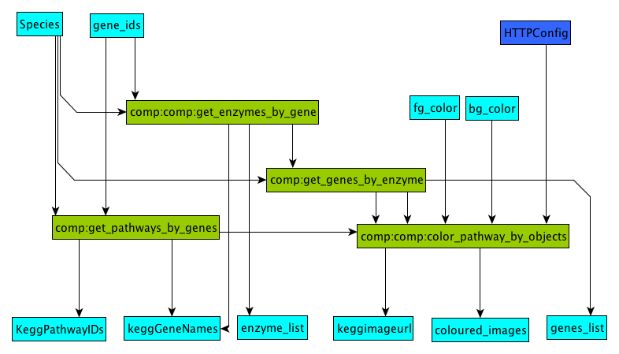
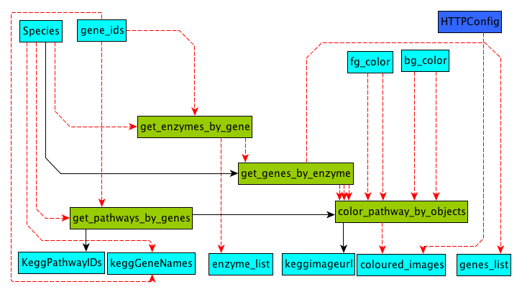
Summaries at a glance
Causal Ordering of operations
Reduced depth
By-Collapse
By-Elimination
Notes:
For example, In Figures 7 and 8 we provide the result of applying the two summarization rules to our sample genomics workflow. Both strategies result in a process-wise compact version of the workflow that contains only the Data Retrieval operations that have survived elimination after exhaustive execution of the rules. The summaries convey the causal ordering of these operations and their direct/indirect

Slide 81
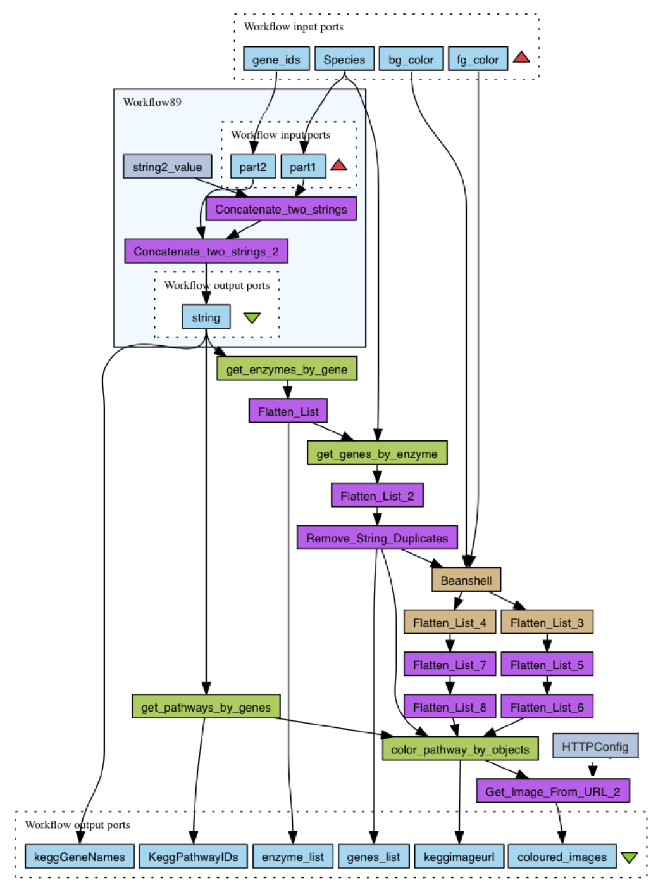
By-Collapse

Slide 82
By-Elimination

Slide 83
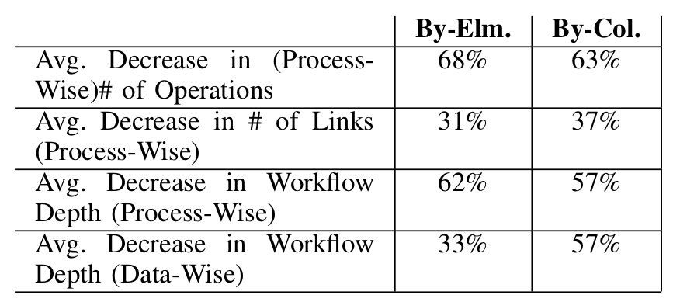
Mechanistic Effect of Summarization

Slide 84
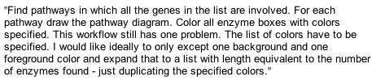

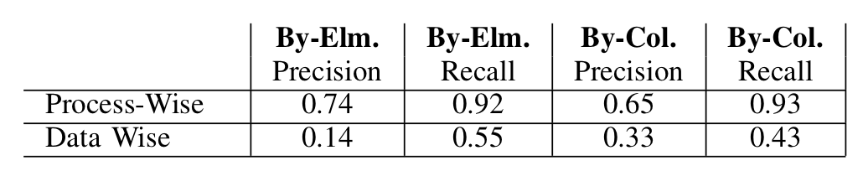
User Summaries vs. Summary Graphs

Slide 85
Take Aways
Establishing Trust, but also understanding and reusability, in Computational Science is more than ever needed
Reproducibility seems to be a cost-effective solution
A number of tools and methods have been developed for doing so.
However, …. that is not enough
Changing our ways (culture) of doing science is more challenging

Slide 86
Acknowledgement
Pinar Alper
Óscar Corcho
Fernando Chirigati
Juliana Freire
David De Roure
Yolanda Gil
Daniel Garijo
Carole Goble
David Koop
Stian Soiland-Reyes
Paolo Missier
Jun Zhao
and many others …

